Slide 1


Opportunity Cost
  Opportunity Cost – used by economists to measure the cost of decision-making; the value of the what we give up
  Next best alternative use of money, time, or resources
Sleeping (Opportunity Cost)
Coming to Economics

Slide 2
Today’s Assignments
Short Answer Opportunity Cost and the PPF pgs. 8-18
Scarcity Article and Questions, found under “online assignments” link

Slide 3
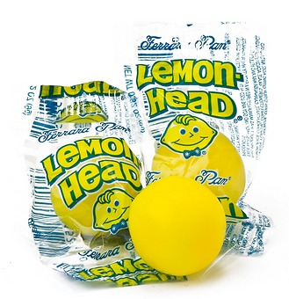
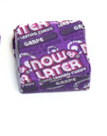

Slide 4
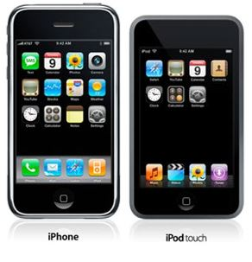


Trade-Offs
Individuals and Trade-Offs – studying one subject vs. another, watching TV or working out, etc.
Business Trade-Offs – producing iPod vs. iPhone
Society and Trade-Offs – “guns or butter”, military or consumer goods

Slide 5


Decision-Making Grid
or
Alternatives | Criteria
 | Immediate Satisfaction | Long Term Benefits | Entertaining | Immediate Financial Benefits | Necessary for Long-term success
90 minutes of Sleep
90 minutes of Economics
Yes
No
Yes
No
No
Yes
Yes
Yes
No
Yes

Slide 6
Decision-Making Grid
or
Alternatives | Criteria
 | Immediate Satisfaction | Long Term Benefits | Entertaining | Immediate Financial Benefits | Necessary for Long-term success
Sleep
Economics
Yes
No
Yes
No
No
Yes
Yes
Yes
No
Yes

Slide 7


Thinking at the Margin
Hour | Sleep | Planning
6:15
6:30
6:45
15
15
- - -
- - -
15
15

Slide 8

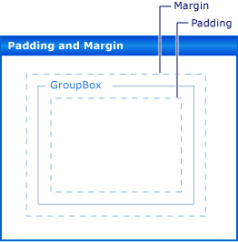
Thinking at the Margin
Margin – an increment (small unit), a border/edge
Thinking at the margin – analyzing the costs and benefits of incremental (small) decisions

Slide 9
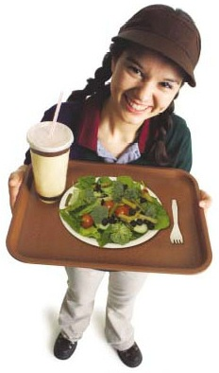

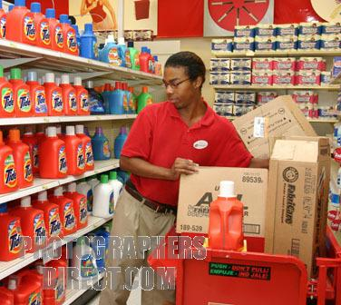
Thinking at the Margin
Hours | Pay | Opportunity Cost
40
41
42
43
$9.00
13.50
13.50
13.50
40 hours of play
1 hour playing video games
1 hour with family
1 studying economics

Slide 10



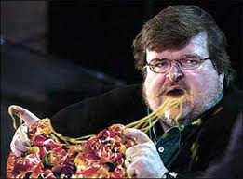
Thinking at the Margin
Slice | Marginal Benefit
1
2
3
4
5
6
7
8
10
9
8
4
2
0
-2
-10

Slide 11
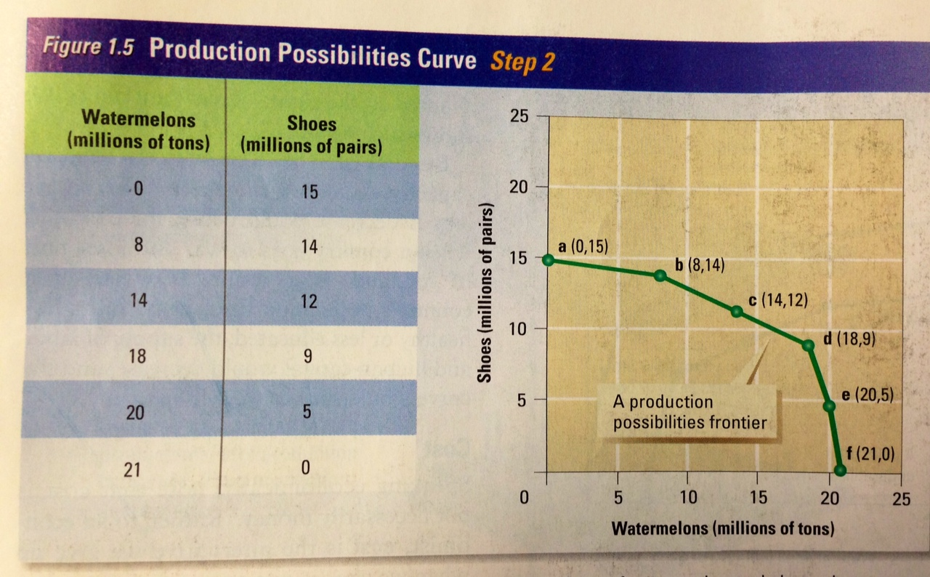

Slide 12
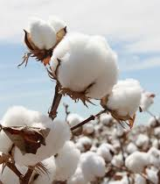
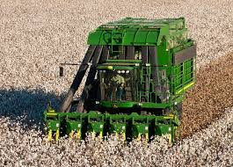
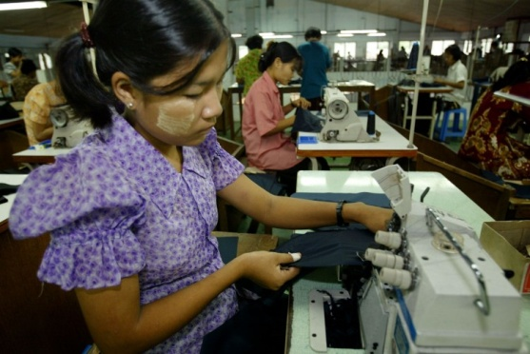

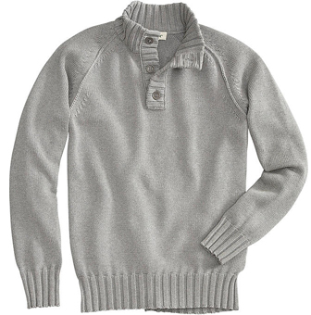
Factors of Production
Land
Capital
Labor
Entrepreneur
+
+
+
=

Slide 13
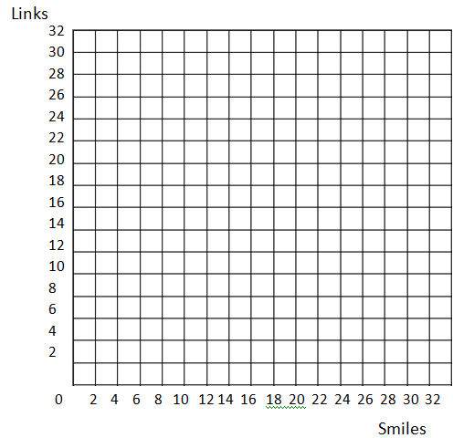
Production Possibilities Frontier Activity
Identify Factors of Production:
Paper _____________________________
Pencil, scissors, roll of tape ________________________
Group members ______________________________
You will have 3 5 minute rounds of production:
  2 sheets folded in pattern a
Round 1: Make only links
Round 2: Make only smiles
Round 3: Make half smiles and half links
Round 4 (fired worker 1 paper):
Make half smiles and half links
Round 5 (rehired 4 pieces of paper plus extra
scissors: Make half smiles and half links
Land
Links | Smiles
Physical Capital
Laborers

Slide 14
Production Possibilities Frontier Activity
Round | Links | Smiles

Slide 15
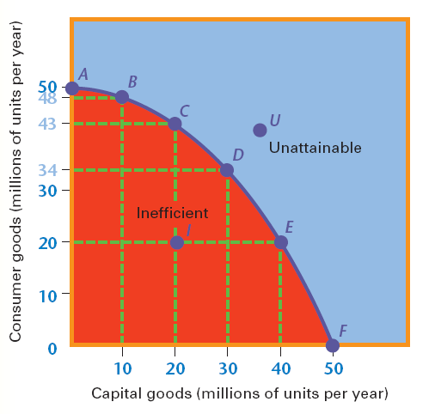
Production Possibilities Model
What is the PPC Model?
  PPC Model – shows/illustrates the possible combinations of goods and services that can be produced by a single nation, firm or individual given the productive resources available
What does it show?
  That nothing is free and that everything has an opportunity cost
  If society wants more of one thing then it must give up something in return
  Used to visually represent opportunity cost

Slide 16
Basics of the production possibilities frontier model
Unattainable/Economic Growth
A
E
B
Frontier
/Efficiency
Underutilization
/Inefficiency
D
C
1,000

Slide 17

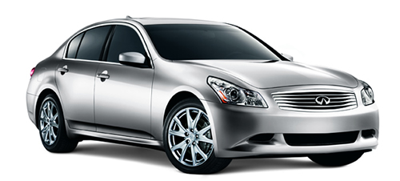
Production Possibilities Model
What basic economic concepts can it be used to model?
  Scarcity
  Tradeoffs
  Opportunity cost
  Economic growth
  Efficiency
  Unemployment
Quantity of
Computers
Produced
3,000
F
Production
Possibilities
Frontier
2,200
A
2,000
B
1,000
E
0
300
600
700
1,000
Quantity of
Cars Produced

Slide 18

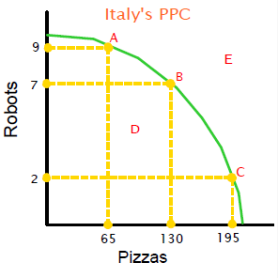
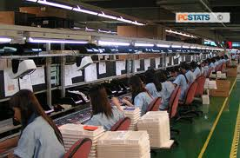
Production Possibilities Curve
  Efficiency – what one is capable of producing; using resources in such a way as to maximize the production of goods and services *
  Points along the curve, (a – c) *
Efficiency

Slide 19
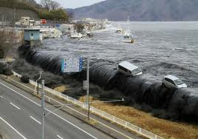
Underutilization (Inefficiency)
Underutilization – using fewer resources than an economy/business is capable of; inefficient use of resources
    Points inside the curve, d (inefficient use of resources)
Underutilization
/Inefficiency

Slide 20
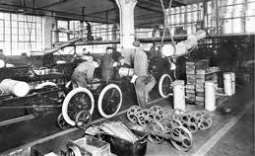
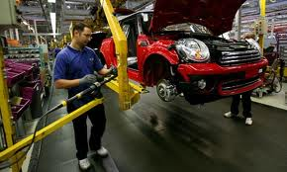
Growth
  Growth (future technology) – the change in ability to produce, reflects a change in the curve; Currently unattainable level of production
  New frontier (usually as a result of new technology)
Growth

Slide 21
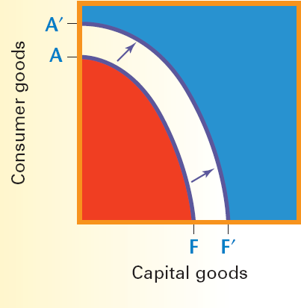
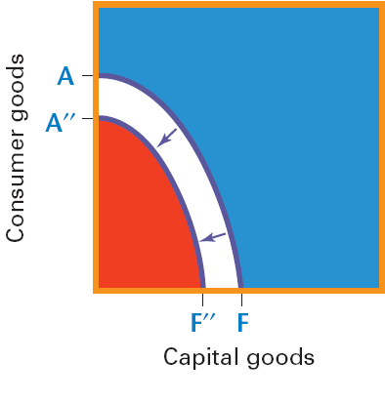
Shifts in the PPF
Increase in available resources
Decrease in available resources

Slide 22
12
10
8
6
4
2
PPC Activity
Good A | Good B
0 | 12
1 | 10
2 | 8
3 | 6
4 | 4
5 | 2
6 | 0
Good B
0
1 2 3 4 5 6
Good A
Answer the following questions based on the model above:
The opportunity cost of increasing production from Good A from zero units to one unit is the loss of __________ unit (s) of Good B.
The opportunity cost of increasing production from Good A from one unit to two units is the loss of __________ unit (s) of Good B. The total loss is ____
The opportunity cost of increasing production from Good A from zero units to 6 units is the loss of _________ unit (s) of Good B.

Slide 23
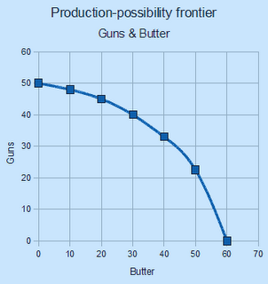
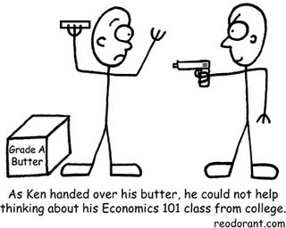
Review - Guns or Butter PPF
How many guns can be produced when no butter is produced? ________
How much butter can be produced when no guns are produced? _______
The opportunity cost of increasing the production of guns from 0 to 40 units is ________ units of butter.
What would it say about this society if the production decision was to produce at the (45, 20) point; assuming that it takes 30 units of butter to provide basic foodstuffs to society and 40 units of Guns to protect their society? ___________________________________________________
This society cares more about military than providing consumer goods for the people

Slide 24
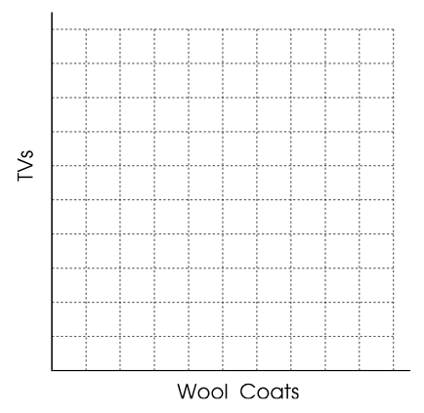
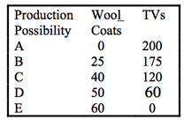
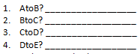
PPF Exercise
A
200
B
180
160
140
C
80
120
100
25
55
40
80
D
80
60
40
20
E
5 10 15 20 25 30 35 40 45 50 55 60
Along the curve (frontier)
Inside the curve
Outside the curve

Slide 25
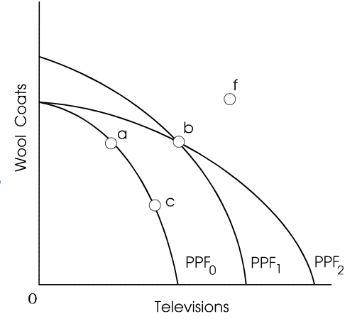
PPF Exercise
True
False
True
True
False

Slide 26
Today’s Assignments
Group Work – PPF, #’s 5 – 8
Individual Work – Study Guide and Terms

Slide 27
Today’s Assignments
What is Economics? Open Notes Quiz (Ch.1)
Production Possibilities Curve Open-Notes Quiz

Slide 28
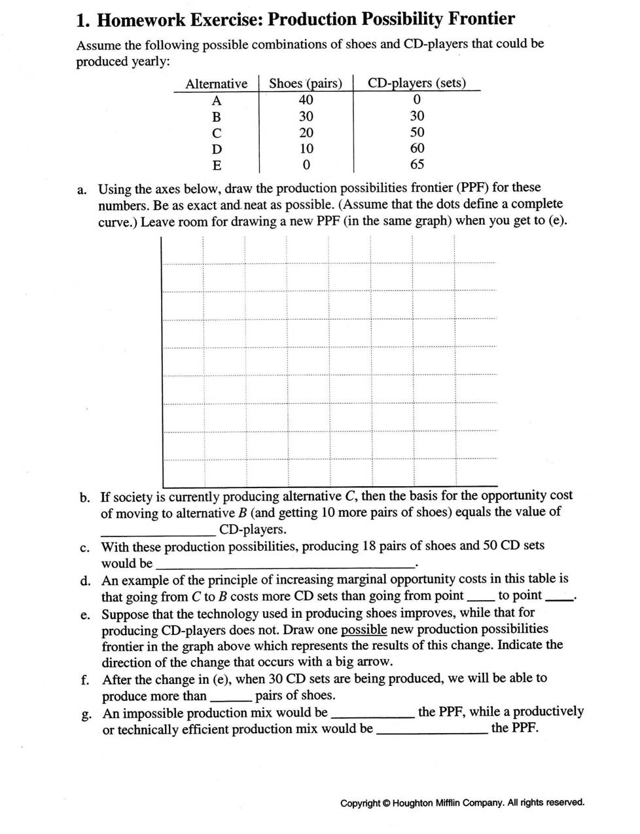
Shoes
A
40
35
B
30
25
C
20
15
D
10
5
E
CD Players
10 20 30 40 50 60 70

Slide 29
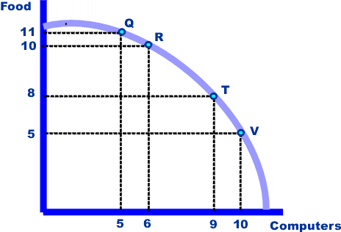
What do points Q, R, T and V represent? __________________________________________
What does an efficient use of resources mean? ____________________________________
How much food and computers are being produced at point R?
  Food ______________
  Computers ______________
If we move from point T to V, how many computers are gained and how much food is lost?
  Computers gained ___________
  Food lost ____________
What is the term used to describe the cost of increasing one item in order to produce the other item? ________________________________________

Slide 30
What terms could be used to describe this PPF if production was at the 5, 5 point of the graph? _______________________________________
What might have caused the condition in the previous question? __________________________________________
Illustrate economic growth by labeling a “z” point on the PPC diagram above.
What are some factors that might contribute to economic growth?
___________________________________________________________________________

Slide 31
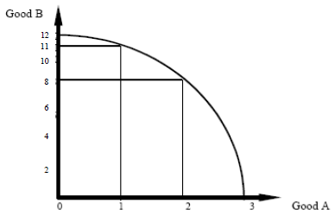
The opportunity cost of increasing production of Good A from 0 units to 1 unit is the loss of _______ unit(s) of Good B.
The opportunity cost of increasing production of Good A from 1 unit to 2 units is the loss of _______ unit(s) of Good B.
The opportunity cost of increasing production of Good A from 2 units to 3 units is the loss of _______ unit(s) of Good B.
The opportunity cost of increasing production of Good A from 0 units to 2 units is the loss of _______ unit(s) of Good B.
The opportunity cost of increasing production of Good A from 0 units to 3 units is the loss of _______ unit(s) of Good B.
The opportunity cost of increasing production of Good B from 11 units to 12 units is the loss of _______ unit(s) of Good A.
The opportunity cost of increasing production of Good B from 0 units to 11 units is the loss of _______ unit(s) of Good A.

Slide 33
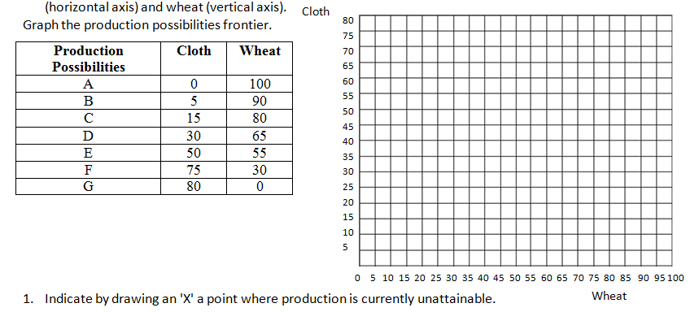

Slide 34
Today’s Assignment
Production Possibilities Curve Open-Notes Quiz
What is Economics? Open Notes Quiz (Ch.1)
USA Test Prep – Scarcity, Opportunity Cost and the PPF

Slide 35
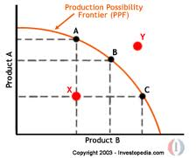
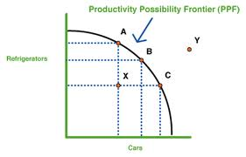
321 Summarizer
Write 3 things you learned today.
Write 2 ways that this lesson can apply be useful to your life.
Write 1 question you still have

