Slide 1
Activator
During the holiday season of 1996, a children's toy appeared on Good Morning America. The toy, produced by Mattel, had sat on the shelves with very little sales until it appeared on the show. After the toys appearance, its popularity improved and it became the most sought after product of the holiday season. Unfortunately, Mattel did not anticipate the doll’s popularity, only producing 400,000 units, and were not able provide the product in a timely manner at the store level (over 1,000,000 were in demand).

Slide 2
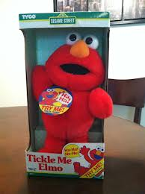
Elmo was sold for as much as $2500 through a classified ad

Slide 3
Elmo Videos
Elmo Commercial
Elmo Good Morning America

Slide 4
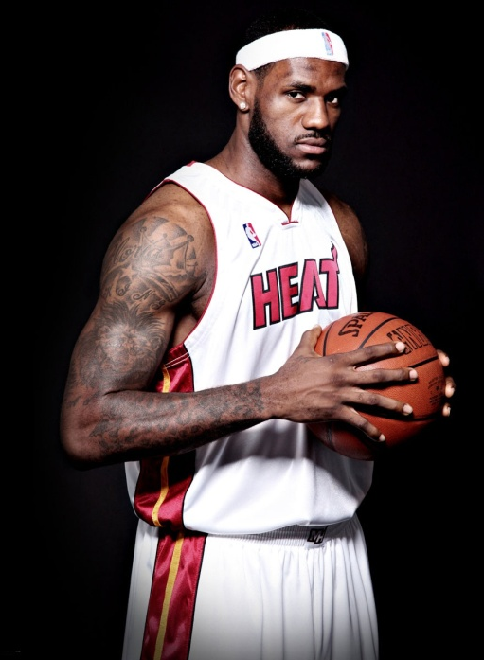
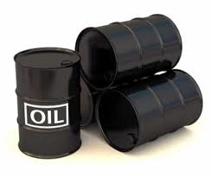
Fundamental Economic Concepts Scarcity and the Factors of Production
Scarcity - fundamental problem facing all people; unlimited wants and limited resources to satisfy those wants
The Basic Economic Problem:
Humans' wants and needs are infinite, while the resources needed to satisfy those wants and needs are limited and scarce.

Slide 5
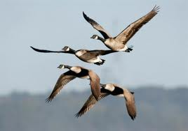
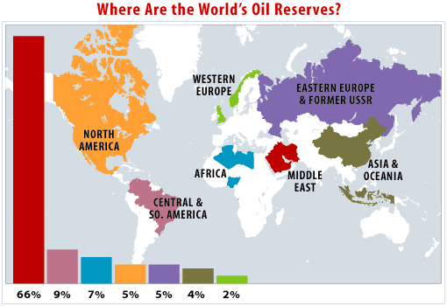
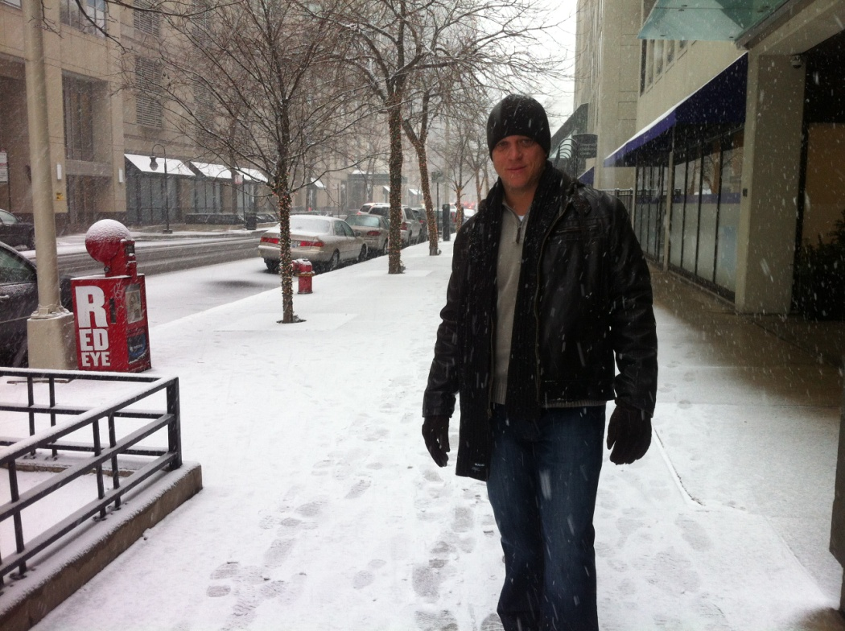
Scarcity
What makes something scarce?
Something is scarce when it is both limited and desirable
e.g. - Lebron James, oil, time, rest, grass in the winter (north) etc.
Scarcity applies to everyone
Scarcity represents permanent problems that cannot be solved

Slide 6
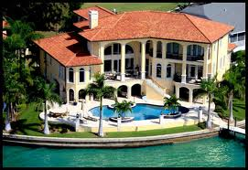
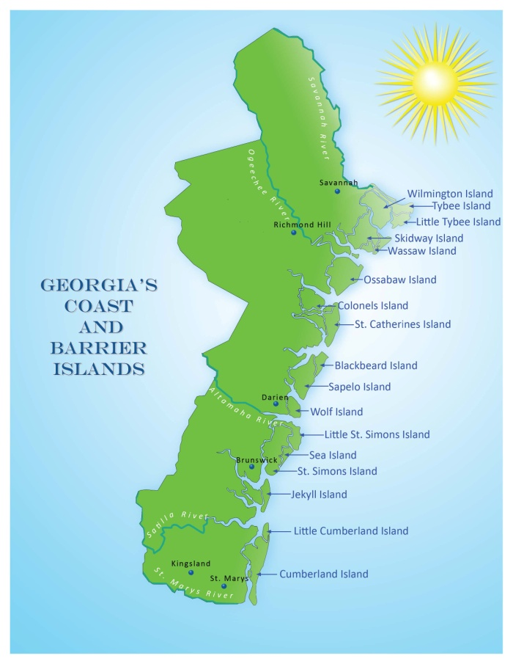
How to allocate (distribute) scarce resources Who gets scarce stuff?

Slide 7
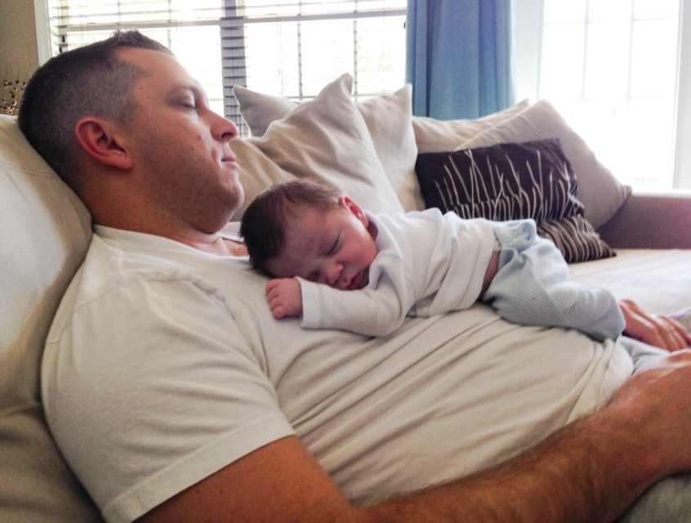
Application Question
List three things that you feel are scarce in your life, what has caused them to become scarce?

Slide 8
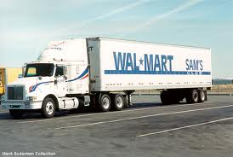
What is Economics?
Economics – the study of choices; how individuals and groups seek to satisfy their wants and needs in light of scarcity

Slide 9
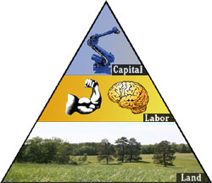
What are the Scarce Resources? Factors of Production
Factors of Production - resources required to produce goods and services

Slide 10
Land
Land – natural resources not created by human effort that are used to produce goods and services
The "gifts of nature".
Examples: Forests, fish, oil, gas, cattle, etc...

Slide 11
Labor
Labor – time and effort that a person devotes to producing goods and services.
Labor resources are those provided by the body and minds of men and women.
Examples: doctors, teachers, construction workers, etc...

Slide 12
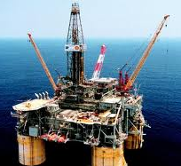
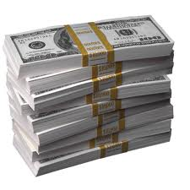
Capital
Physical Capital – also known as Capital Goods, human made objects used to create other goods and services
Examples: Machines, phones, computers, equipment
Human Capital – skills, abilities, and specialized talents of people
Examples: College, training, technical school, etc.
Financial Capital – money, used by businesses to invest in their business
Examples: money

Slide 13
Entrepreneurs
Entrepreneurs – ambitious business people who organize the factors of production to create new goods and services
Entrepreneurs are the "risk takers" who produce a good or service that they believe will succeed in the marketplace.

Slide 14
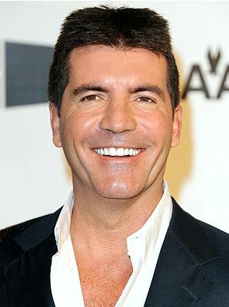
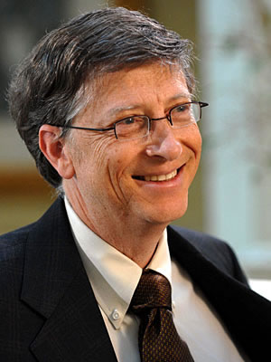
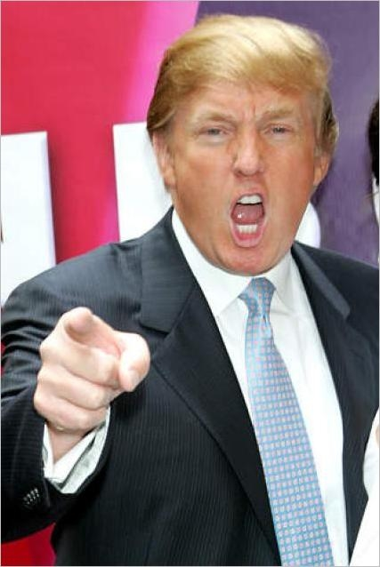
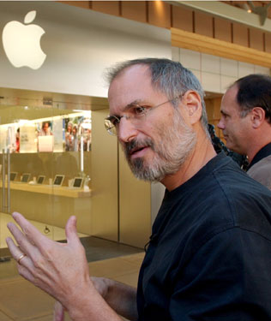
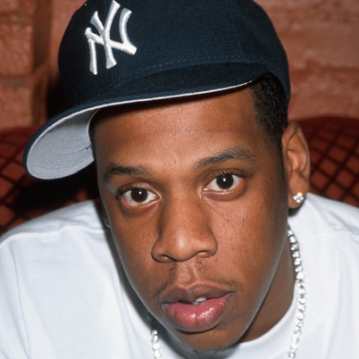

Slide 15
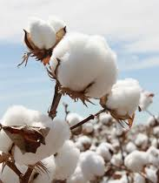
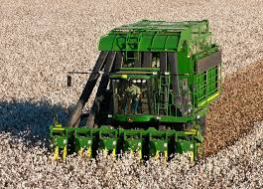
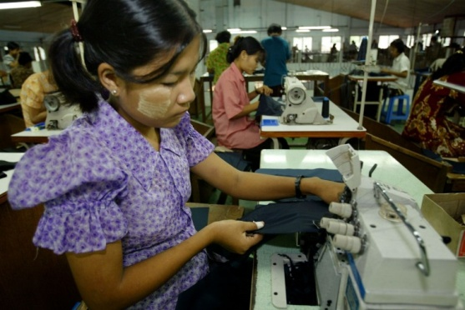
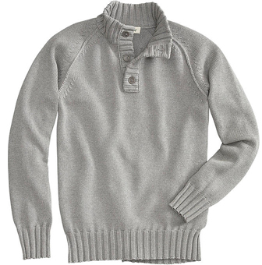
Factors of Production
Land
Capital
Labor
Entrepreneur
+
+
+
=

Slide 16
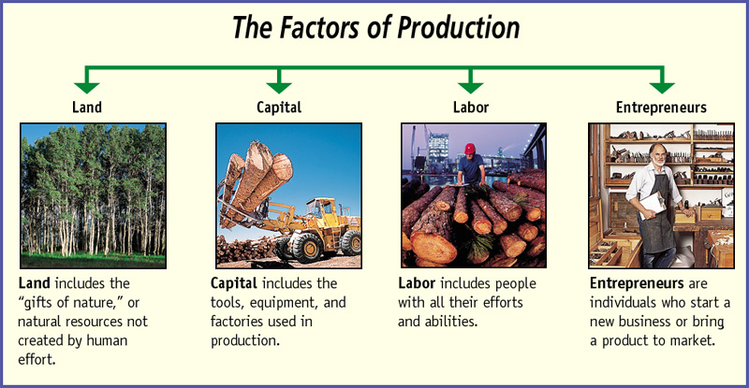
Factors of Production

Slide 17
Scarcity Videos
Water Scarcity
Water Scarcity Part 2
Scarcity Video

Slide 18
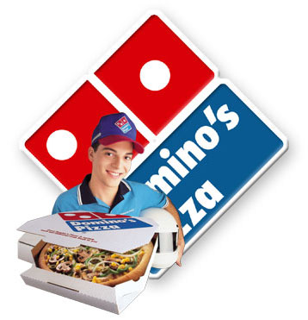
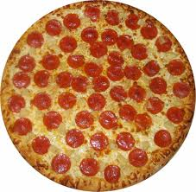
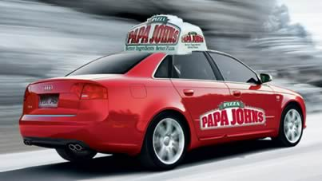
Classify the Factors of Production in the following scenario:
You decide to order a pizza to satisfy your wants. First, you picked up the telephone and gave your order to the owner that entered it into her computer. The information came up on the chief baker’s monitor in the kitchen and he assigned it to one of his cooks. The cook cook used his knowledge of mixing dough out of salt, flour, eggs, and milk. The cook finished mixing dough, washed his hands in the sink, and prepared your pizza using tomato sauce, cheese, and sausage. He then placed the pizza in the oven. Within 10 minutes the pizza was cooked and placed in a cardboard box. The delivery person then grabbed your pizza, jumped in the company car, and delivered it to your door.

Slide 19
Classify the Factors of Production in the following scenario:
Owner _________________________________
Computer _________________________________
Chief baker’s monitor _________________________________
Kitchen _________________________________
Cooks _________________________________
Knowledge of mixing dough _________________________________
Salt, flour, eggs, and milk _________________________________
Sink _________________________________
Tomato sauce, cheese, and sausage _________________________________
Oven _________________________________
Cardboard box _________________________________
Delivery person _________________________________
Company car _________________________________
Entrepreneur
Physical Capital
Physical Capital
Physical Capital
Labor
Human Capital
Land
Physical Capital
Land
Physical Capital
Physical Capital
Labor
Physical Capital

Slide 20
Examples of Factors of Production
Land | Labor | Capital | Entrepreneurs
1. | 1. | 1. | 1.
2. | 2. | 2. | 2.
3. | 3. | 3. | 3.

Slide 21
Needs vs. Wants
Need – a basic requirement for survival
e.g. – food, clothing, education, etc…
Want – not a basic requirement for survival; a means of expressing a need
e.g. – cheeseburger, Abercrombie and Fitch, University of Georgia, etc…
OR

Slide 22
Good – physical, tangible(touchable) product
Goods
i.e. – Automobiles, Video Games, Cell Phones, CD’s, Tickle Me Elmo, etc…

Slide 23
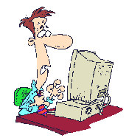
Service – a non-tangible action or activity that is performed for someone else
Services
i.e – Financial Advisor, Stock Broker, Movies, Dentist, Teachers, etc..

Slide 24
Show 4/5Commercials for following Chart

Slide 25
Goods and Services Chart
Item advertised | Good/Service | Want/Need | Market

Slide 26
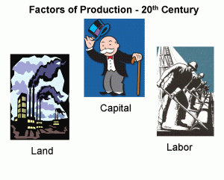
Daily Assignment Chapter 1 Section 1
Why does scarcity apply to everyone?
List a good and a service that you have purchased in the past month.
What are some things that you have that might be considered wants by other societies? Explain why.
Last year, you were trying to make a decision on what kind of car you wanted your parents to buy you for your birthday. You had two choices: 1) 1984, Honda Accord for $2,000, or 2) 2010 fully stocked Infiniti G37 for $52,000. Which one of these would be considered a want, and which one a need and why?
“Hank” works two jobs, one in the morning and one at night. At his morning job he sells furniture at a furniture store. At his night job he works as a computer technician. Which one of his jobs creates a good and which provides a service?
Microsoft offers all of their employees the opportunity to attend the local university for a higher education, free of charge. What would be the motivation for investing in human capital?
Which factor of production is represented by each of the following? (a) an office building, (b) an assembly line worker, (c) a tree used to make paper, (d) unused soil, (e) Oprah Winfrey

Slide 27
Activator
Directions: On a 3 column chart, label it as shown below. In the second column, list 3 possible alternatives that you could have made other than your choice to come to school. In the third column, list the alternative that you would have desired the most.
Choice | Three Alternatives | What you would have done if you didn’t come to school
Coming to Economics Class | 1. 2. 3. | 1.

Slide 28
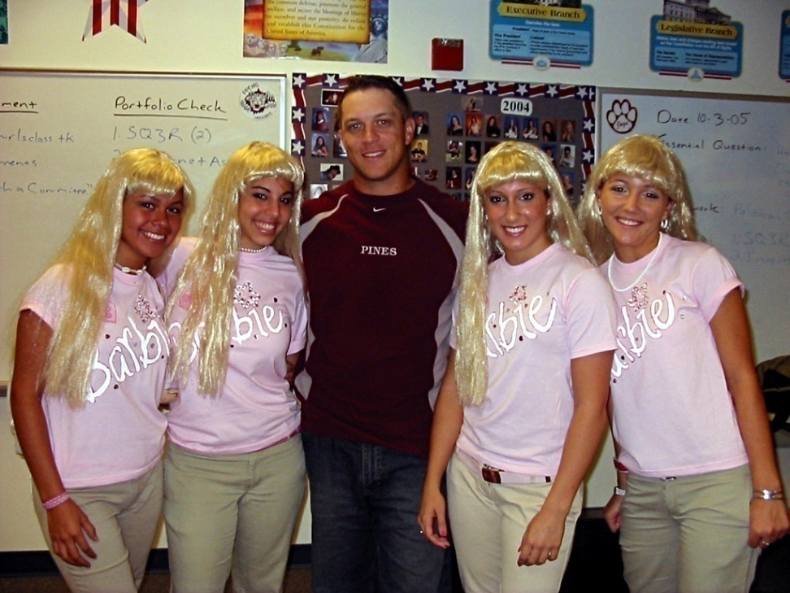
Tradeoffs
Trade-off – alternatives that we give up whenever we choose one course of action over another
We always give up something to get something else
“There is no such thing as a free lunch.” (TINSTAAFL)
Individuals, Businesses and society all face tradeoffs

