Slide 1
Activator
Why do you accept money in exchange for a good or service?
What gives money its value?
Represents purchasing power, acceptable form of currency, other people will accept it, etc…
Government says so, domestically and internationally accepted, represents value of goods and services

Slide 2
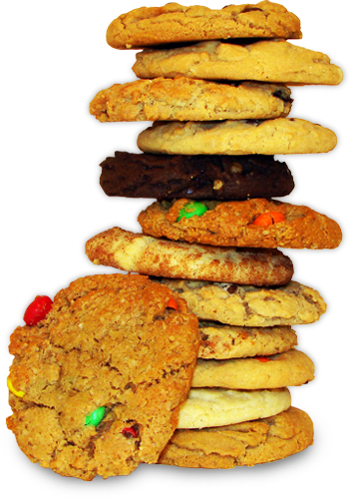
Ingredients
Baking Soda and Salt
Cinnamon, Raisins and Vanilla
Food Coloring
Shortening
Sugar and Flour
Eggs

Slide 3
Chapter 10 Money and Banking Section 1 - Evolution of Money
Money – assets people use to buy goods and services
Something that is regularly accepted in exchange for goods and services
Three Functions of money:
Medium of exchange
Unit of Account
Store of Value

Slide 4
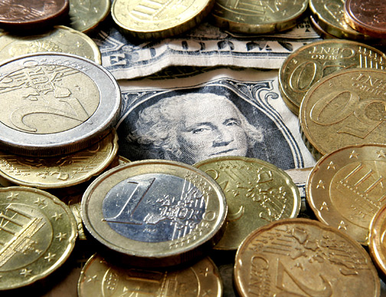
Functions of Money
Medium of Exchange – payment for products; buyers give sellers in exchange for goods/services
Barter system – economy that relies on trade of one product for another
The direct exchange of goods and services for other goods and services.
Double coincidence of wants – situation where two people simultaneously have a product that the other wants

Slide 5
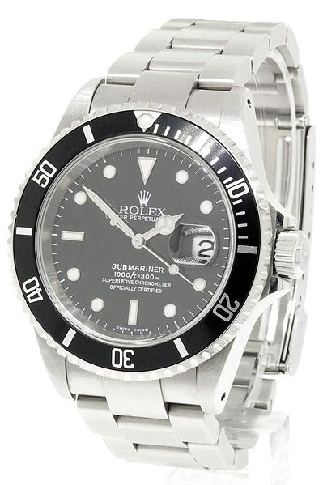
Unit of Account
Unit of Account– an expression of worth; a means for comparing the values of goods and services
Keep track of debts and investments
Fossil – $89.95 Bulova – $399.95 Rolex - $11,995

Slide 6
Store of Value
Store of Value – money keeps its value if you decide to store it instead of spend it
Helps people convert purchasing power from present to future value

Slide 7
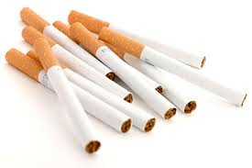
The Kinds of Money
Commodity money – money that has an alternative use as a commodity, which has intrinsic value
Intrinsic value – item would have value if not used as money
Gold, silver, cigarettes (WW2), tulip bulbs (1600’s Europe), etc
Gold standard – gold used as money; money backed by gold

Slide 8
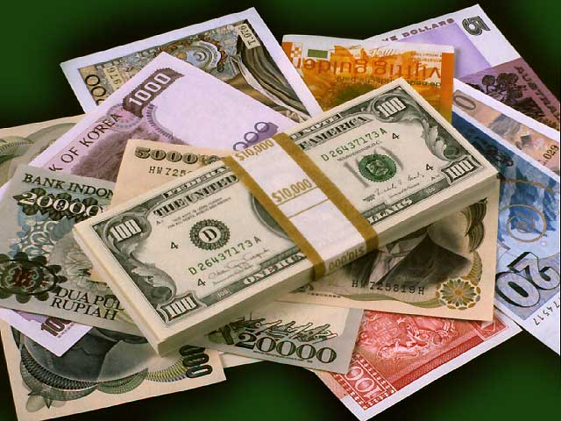
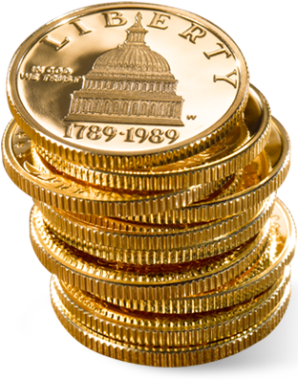
The Kinds of Money
Fiat – order/decree; government issued money
Paper dollars
Money that is intrinsically worthless
Legal tender - is money that a government has required to be accepted in settlement of debts

Slide 9
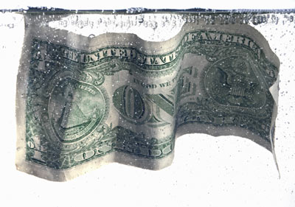
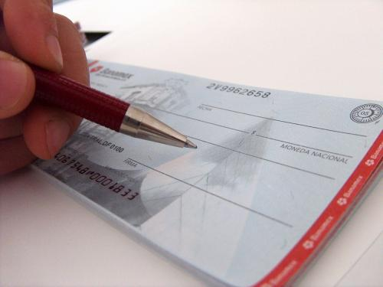
Liquidity
Liquidity – ease with which an asset (liquid asset) can be converted into money/medium of exchange
Liquid – checking account
Nonliquid - House

Slide 10
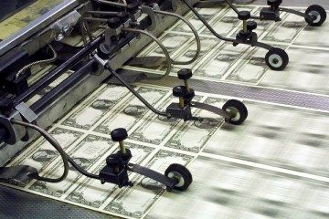
Money in the U.S. Economy
Money stock – quantity of money in the economy
October 2010 – 9.61 Trillion
Currency – paper bills and coins in the hands of the public
Demand deposits – balances in bank checking accounts, can be accessed by writing a check
Debit card/direct deposits, cash transfer, etc.

Slide 11
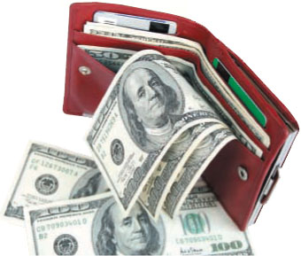
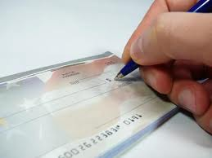
M1 and M2
M1 – money that people can gain access to easily and immediately; checkable demand deposits (balances in bank accounts)
High liquidity - checking accounts, traveler’s checks
M2 – consists of all the assets in M1 plus assets that are not as liquid
Slightly less liquid, savings accounts, money market, mutual funds, etc.

Slide 12
The Six Characteristics of Money – pgs. 245-246
Characteristic | Description | Examples
1. Durability
2. Portability
3. Divisibility
4. Uniformity
5. Limited Supply
6. Acceptability
Must withstand physical wear and tear that is a part of being used over and over again.
Ancient Roman coins more than 2000 yrs. old. Rag/cloth content helps keep money durable (1 yr. life)
People need to be able to take money with them from place to place.
Paper money and coins are easily carried and very portable.
Money must be easily divided into smaller denominations.
Spanish doubloons, U.S. various $1, 5, 10, 20, 50, 100, denominations. Penny, Nickel, Dime, Quarter, etc.
Money must be uniform, easy to count and measure.
A U.S. dollar always buys $1 worth of goods.
The money supply must be kept in limited supply.
Pebbles on the beach (unlimited), US Federal Reserve is responsible for controlling the money supply.
Everyone in an economy must be able to exchange the objects that serve as money.
US we expect money to be accepted domestically and internationally.

Slide 13
Essential Questions
What are the three functions of money?
Medium of exchange – used to buy stuff
Unit of Account – keep track of prices, debts and investments
Store of Value – hold value for future purchases
What are the different types of money?
Commodity money – intrinsic value
Fiat money – no intrinsic value
What are the 6 characteristics of money?
Durability
Portability
Divisibility
Uniformity
Limited in Supply
Acceptability

Slide 14
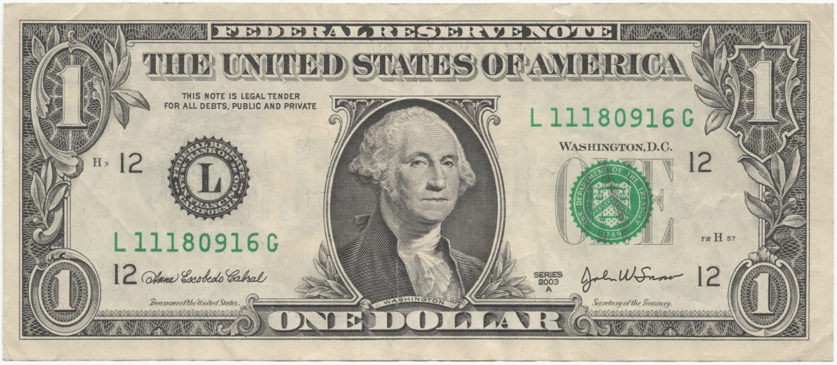
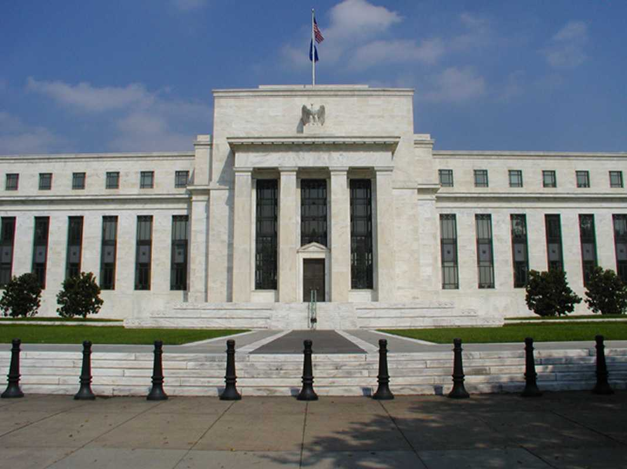
Chapter 16 - The Federal Reserve
The Federal Reserve (“The Fed”) – the central bank of the U.S.
Created in 1913 by Congress, Federal Reserve Act
Central Bank – institution designed to oversee the banking system and regulate the quantity of money in the economy.
Monetary policy – directly affects the nation’s money supply (expansionary or contractionary)
Responsible for regulating the fiat money system
Dollar is officially a “Federal Reserve Note”

Slide 15
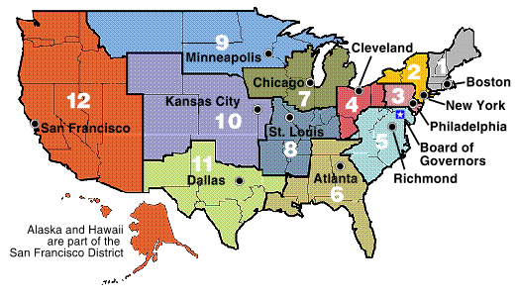
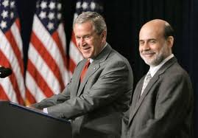
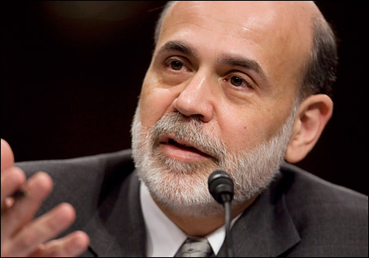
Structure of the Federal Reserve
Run by a 7 member board of governors
Appointed by the president, confirmed by the Senate to 14 year terms
Board is led by the chairman
Current chairman – Ben Bernanke

Slide 16
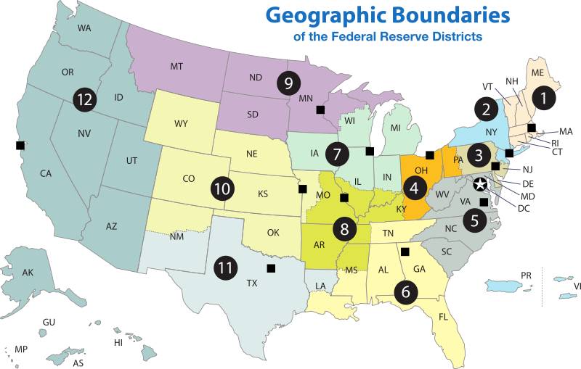
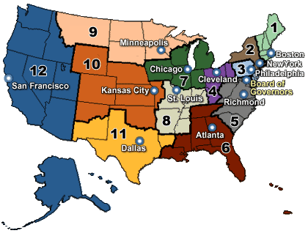
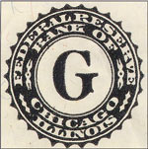
Structure of the Federal Reserve
Fed is comprised of Twelve Federal District Reserve Banks
One Federal Reserve Bank for each district
Each FRB monitors economic and banking conditions in its district

Slide 17
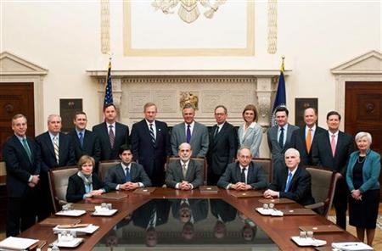
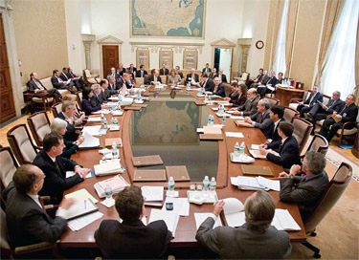
The Federal Open Market Committee
Structure and function:
Run by a 7 member board of governors and 5 of the 12 regional bank presidents
All attend, only 5 vote, President of New York Fed always votes (financial capital of the world
Increase or decrease money supply

Slide 18
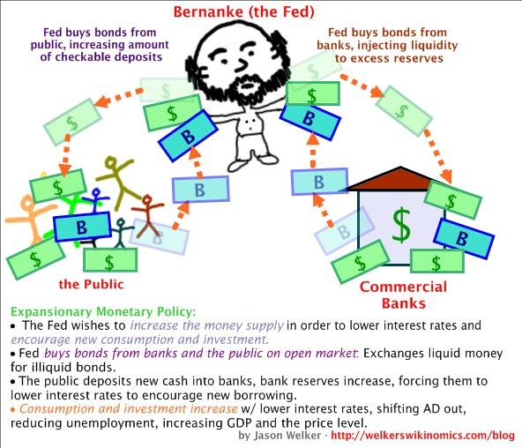
The Fed’s Tools of Monetary Control
Three monetary policy tools
Open-market operations
Reserve requirements
Discount rate

Slide 19
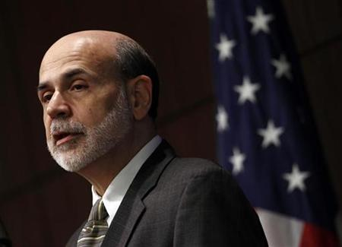
Open-Market Operations
Open-Market Operations – the purchase and sale of U.S. government bonds by the Fed
Most often used tool of the Fed
Buy bonds from the public - increase money supply
Easy money policy - expansionary monetary policy, goal is to expand the economy by lowering interest rates, increase inflation, encourages banks to lend money to consumers , discourage saving, increases the money supply
Decrease money supply, sells government bonds
Tight money policy – contractionary monetary policy, goal is to slow the economy by raising interest rates, cause inflation to slow, discourage borrowing, encourage saving, restricts the money supply

Slide 20
Reserve Requirements
Reserve Requirements – regulations on the minimum amount of reserves that banks must hold against deposits
Banks must have a supply of reserves to protect against "runs" or "panics.“ (it’s a wonderful life video clip)
10% on M1
Influences how much money banks can create from each deposit (reserves)
Increase in RRR, banks must hold more reserves, can loan out less
Decrease in RRR, banks must hold less reserves, can loan out more
Country | 1968 | 1978 | 1988 | 1998
United Kingdom | 20.5 | 15.9 | 5.0 | 3.1
Turkey | 58.3 | 62.7 | 30.8 | 18.0
Germany | 19.0 | 19.3 | 17.2 | 11.9
United States | 12.3 | 10.1 | 8.5 | 10.3

Slide 21
Banking Simulation
Name | Deposit Amount | Required Reserves | Excess Reserves
Total

Slide 22
Banking Simulation
Loans
Name | Loan Amount
Total
Total Deposits ___________
Total Reserves ___________
Total Loans ___________
Excess Reserves ___________
Remaining Excess Reserves _______

Slide 23
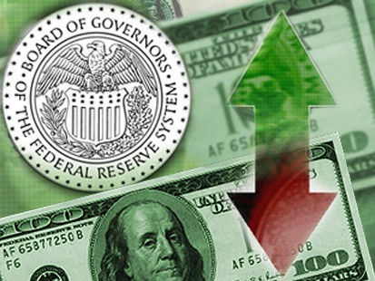
The Discount Rate
Discount Rate – interest rate on loans the Fed makes to banks; currently .75%
Fed is the lender of last resort
Banks borrow from Fed when it has low reserves; too many loans, high withdrawals
Lower discount rate encourages borrowing
Higher discount rate discourages borrowing
Federal Funds Rate – short-term interest rate that banks charge each other for loans
Currently 0 - .25%

Slide 24
Open-Market Operations Simulation
Initial Money Supply _______________
After Bond Swap _________________
After Open-market purchase _____________________
After Open-market sale ________________________
What are the three tools of monetary policy?
Open-market operations, Required Reserve Ratio, Discount Rate/Federal Funds Rate (Interest Rates)
Which tool of monetary policy is used most frequently?
OMOs
How do open market operations affect the money supply?
Purchase – increase m.s. Sell – decrease m.s.
What is the structure of the Fed?
Central Bank – DC (7 governors) + 12 district banks

Slide 25
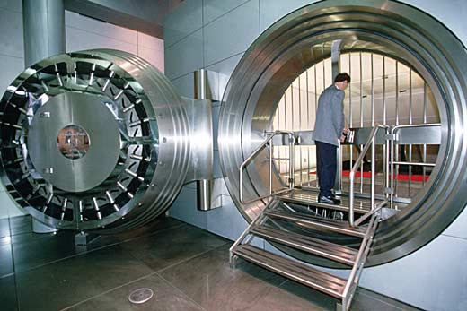
Money Creation
Fractional-reserve system – banks hold only a fraction of deposit reserves as opposed to a 100% reserve system
Reserve – money deposit that banks have received but not loaned out
Reserves and loans are assets to bank
Loans are liabilities to borrowers, deposits are liabilities to the bank

Slide 26
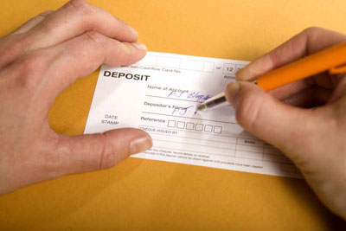
Money Creation
Required Reserve Ratio – set by the Fed, minimum amount that must be held by the bank (required reserves)
Established by the Federal Reserve, 1/10 or 10% of M1
Excess Reserves – reserves in addition to required reserves
$1000 deposit, the bank would hold $100 in reserve and have $900 for lending

Slide 27
Money Creation
T Account – simplified accounting statement that shows changes in the banks assets and liabilities
Reserves and loans are assets to bank
Deposits are liabilities to the bank
T-Account for a Typical Bank
 | ASSETS |  | LIABILITIES
Reserves | 10 |  | 100 |  | Deposits
Loans | 90
Total | 100 |  | 100 |  | Total

Slide 28
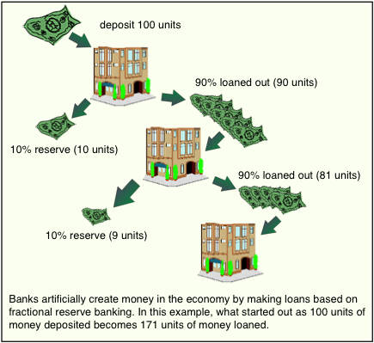
Money Multiplier
Money multiplier formula – helps determine the amount of money that the banking system generates with each dollar of reserves
MM = 1/RRR
1/.10 = 10
1/.05 = 20
Money Creation
Initial Cash Deposit (principal) x MM
The higher the RRR, the less banks have to loan out (vice versa)
100(10) = 1000
100(20) = 2000

Slide 29
Money Multiplier
Personal Deposit | Deposit (Money Supply) | Required Reserves (Assets) | Excess Reserves (Liabilities)
Person A | $2,000
Person B
Person C
Totals

Slide 30
Money Multiplier
Personal Deposit | Deposit (Money Supply) | Required Reserves (Assets) | Excess Reserves (Liabilities)
Person A | $2,000 | $200
Person B
Person C
Totals

Slide 31
Money Multiplier
Personal Deposit | Deposit (Money Supply) | Required Reserves (Assets) | Excess Reserves (Liabilities)
Person A | $2,000 | $200 | $1800
Person B
Person C
Totals

Slide 32
Money Multiplier
Personal Deposit | Deposit (Money Supply) | Required Reserves (Assets) | Excess Reserves (Liabilities)
Person A | $2,000 | $200 | $1800
Person B | $1800
Person C
Totals

Slide 33
Money Multiplier
Personal Deposit | Deposit (Money Supply) | Required Reserves (Assets) | Excess Reserves (Liabilities)
Person A | $2,000 | $200 | $1800
Person B | $1800 | $180
Person C
Totals

Slide 34
Money Multiplier
Personal Deposit | Deposit (Money Supply) | Required Reserves (Assets) | Excess Reserves (Liabilities)
Person A | $2,000 | $200 | $1800
Person B | $1800 | $180 | $1620
Person C
Totals

Slide 35
Money Multiplier
Personal Deposit | Deposit (Money Supply) | Required Reserves (Assets) | Excess Reserves (Liabilities)
Person A | $2,000 | $200 | $1800
Person B | $1800 | $180 | $1620
Person C | $1620
Totals

Slide 36
Money Multiplier
Personal Deposit | Deposit (Money Supply) | Required Reserves (Assets) | Excess Reserves (Liabilities)
Person A | $2,000 | $200 | $1800
Person B | $1800 | $180 | $1620
Person C | $1620 | $162
Totals

Slide 37
Money Multiplier
Personal Deposit | Deposit (Money Supply) | Required Reserves (Assets) | Excess Reserves (Liabilities)
Person A | $2,000 | $200 | $1800
Person B | $1800 | $180 | $1620
Person C | $1620 | $162 | $1458
Totals

Slide 38
Money Multiplier
Personal Deposit | Deposit (Money Supply) | Required Reserves (Assets) | Excess Reserves (Liabilities)
Person A | $2,000 | $200 | $1800
Person B | $1800 | $180 | $1620
Person C | $1620 | $162 | $1458
Totals | $5420 | $542
Initial Cash Deposit (1 ÷ RRR)
2000 X 10 = $20,000

Slide 39
RRR and Money Multiplier Worksheet
RRR | Required Reserves | Excess Reserves
1%
$10
990
5%
$50
950
10%
$100
900
15%
$150
850
25%
$250
750

Slide 40
Money Multiplier
Personal Deposit | Deposit (Money Supply) | Required Reserves (Assets) | Excess Reserves (Liabilities)
Person A | $1,000 | 100 | 900
Person B
Person C
Person D
Person E
Totals

Slide 41
Money Multiplier
Personal Deposit | Deposit (Money Supply) | Required Reserves (Assets) | Excess Reserves (Liabilities)
Person A | $1,000 | 100 | 900
Person B | 900 | 90 | 810
Person C
Person D
Person E
Totals

Slide 42
Money Multiplier
Personal Deposit | Deposit (Money Supply) | Required Reserves (Assets) | Excess Reserves (Liabilities)
Person A | $1,000 | 100 | 900
Person B | 900 | 90 | 810
Person C | 810 | 81 | 729
Person D
Person E
Totals

Slide 43
Money Multiplier
Personal Deposit | Deposit (Money Supply) | Required Reserves (Assets) | Excess Reserves (Liabilities)
Person A | $1,000 | 100 | 900
Person B | 900 | 90 | 810
Person C | 810 | 81 | 729
Person D | 729 | 72.9 | 656.10
Person E
Totals

Slide 44
Money Multiplier
Personal Deposit | Deposit (Money Supply) | Required Reserves (Assets) | Excess Reserves (Liabilities)
Person A | $1,000 | 100 | 900
Person B | 900 | 90 | 810
Person C | 810 | 81 | 729
Person D | 729 | 72.9 | 656.10
Person E | 656.10 | 65.61 | 590.49
Totals

Slide 45
Money Multiplier
Personal Deposit | Deposit (Money Supply) | Required Reserves (Assets) | Excess Reserves (Liabilities)
Person A | $1,000 | 100 | 900
Person B | 900 | 90 | 810
Person C | 810 | 81 | 729
Person D | 729 | 72.9 | 656.10
Person E | 656.10 | 65.61 | 590.49
Totals | 4095.10 | 409.51
3. From person A to B the money supply rose to $1900
4. In only 5 rounds of spending the money supply rose from $1000 to 4095.10
5. What would happen if the bank continued to loan excess reserves? The money could potentially grow to $10,000

Slide 46
RRR and Money Multiplier Worksheet
RRR | Initial Deposit | Multiplier | Increase in Money Supply
1%
$1000
100
$100,000
5%
$1000
20
$20,000
10%
$1000
10
$10,000
15%
$1000
6.6
$6,666
25%
$1000
4
$4,000
1%
Did not grow as much
Hyperinflation
Lack of growth in the economy

Slide 47
RRR and Money Multiplier Review
A $2000 deposit is made in the bank and the RRR is 12%.
How much must be held as required reserves?
How much will be available in excess reserves?
How much could the initial deposit increase the money supply if the RRR was 12%?
How much could the initial deposit increase the money supply if the RRR was 10%?
How much could the initial deposit increase the money supply if the RRR was 5%?
Which RRR yielded the greatest amount? Explain why.
2000 x .12 = $240
2000 – 240 = $1760
MM = 1/.12 = 8.3
2000 x 8.3 = $16,666.67
MM = 1/.10 = 10
2000 x 10 = $20,000
MM = 1/.05 = 20
2000 x 20 = $40,000
5%. The lower the RRR, the higher the excess reserves available to loan out, which subsequently add a greater amount to the money supply.

Slide 48
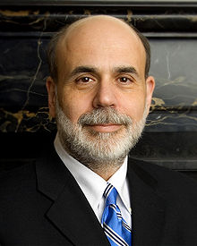
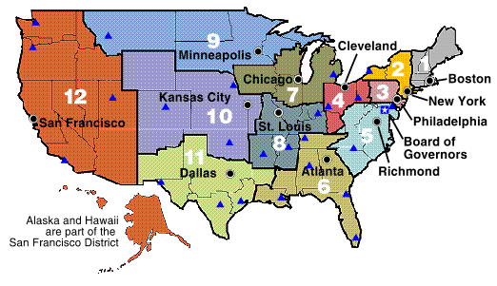
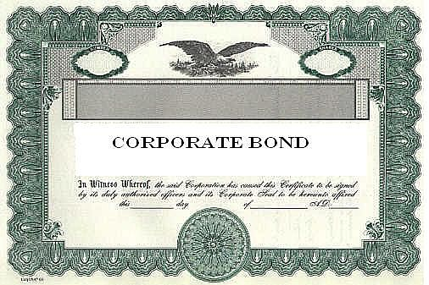
The FederalReserve
“The FED”
Board of Governors (7)
Washington D.C (Public)
12 District Banks (Private)
Federal Open Market Committee (FOMC)
Money Supply
1. Open Market Operations
2. Required Reserve Ratio (RRR)
3. Discount Rate/ Federal Funds Rate
Buying and selling of government bonds
Percentage of demand deposits that must be held in reserves (.10)
Interest rate charged to member banks by the Fed/I.R. charged on overnight lending from bank to bank
Sell Bonds – Decrease MS Increase IR
Buy Bonds – Increase MS Decrease IR
Increase RRR – Decrease MS Increase IR
Decrease RRR – Increase MS Decrease IR
Increase – Decrease MS Increase IR
Decrease – Increase MS Decrease IR

Slide 49
Essential Questions
What is the structure of the Federal Reserve System?
7 Board of Governors at the U.S. Central Bank in D.C.
12 District Banks
What are the three tools of monetary policy used by the FED?
Open Market Operations
Required Reserve Ratio
Discount Rate (Federal Funds Rate/Interest Rates)
What is the purpose of the FED?
Control and monitor the nation’s money supply and banking system

Slide 50
SQ3R pgs. 420 – 421 Functions of Federal Reserve
Serving Government
Federal Government’s Banker
Government Securities Auctions
Issuing Currency
Serving Banks
Check Clearing
Supervising Lending Practices
Lender of Last Resort

Slide 51
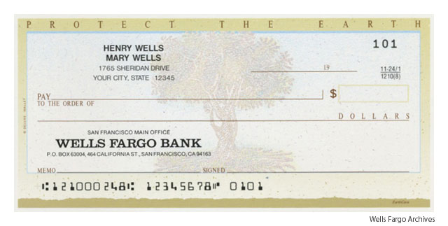
SQ3R
How does the Fed Serve the Government?
Serves the government’s banking needs relative to its budget and taxation
What makes the Fed the Federal Government’s Banker ?
Maintains a checking account for the U.S. treasury
Processes payments, social security checks, IRS refunds, stimulus checks, etc.
How does the Fed sell Government Securities Auctions ?
Sells, transfers, and redeems government bonds, bills, notes, and securities for the government
How does the Fed issue currency?
Department of treasury prints currency, Fed issues it
Take old money out of circulation

Slide 52
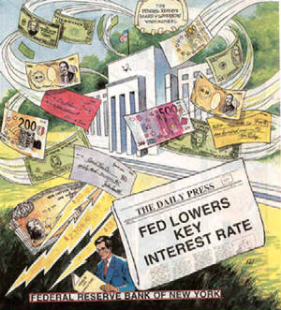
SQ3R
How does the Fed Serve the Banks?
Serves the bank through check clearing services, safeguards bank reserves and lend reserves to banks.
What is the check-clearing function?
Process by which banks record who gives up money and who receives it
Fed clears checks quickly and accurately
What is their supervisory role?
Monitors bank reserves, sends out examiners to check up on lending, rates the banks.
How is the Fed the lender of last resort?
In emergency situations, the Fed can loan money to its member banks
Charge the banks a discount rate

Slide 53
The Fed Today Video Questions
What is a U.S. $20 bill officially?
How many forms of currency existed at one time during the 1800s?
Why did some people lose faith in the banking?
What is the Fed’s primary goal?
What can a fast/slow money supply lead to?
Government securities are in the form of __________
What is the transfer of money from one bank to cover a check called?
How many checks does the Fed clear per year?

Slide 54
Chapter 10 – Practice Worksheet
1. a. Open market operations
b.
2.
3. $18,000
4. 1/.20 = 5
5. $10000 x 5 = $50,000
6. Less, because a smaller amount of each loan gets re-deposited to be available to be loaned again.
7. Less, because a smaller amount of each deposit gets loaned out to be available to be deposited again.

Slide 55
Chapter 10 – Practice Worksheet
8. a. 1,000, because there is 1,000 of currency and 0 of deposits.
b. 1,000, because there is now 0 of currency and 1,000 of deposits.
c. 1,000 x (1/0.20) = 5,000, because 1,000 of new reserves can support 5,000 worth of deposits.
d. The total potential increase is 5,000, but 1,000 was currency already in the system. Thus, an additional 4,000 was created by the banks.
e. 1,000 x (1/0.10) = 10,000.
f. Banks can create more money from the same amount of new reserves when reserve requirements are lower because they can lend a larger portion of each new deposit.
g. 1,000 x 1/(0.10+0.10) = 5,000.
h. Yes, they are the same. With regard to deposit creation, it doesn’t matter why banks hold reserves. It only matters how much they hold.

Slide 56
Binder Check Due Today 4-27
Chapter 10 +16
SQ3R - The Functions of the Fed
The Fed Webquest
RRR + Money Multiplier Worksheet/Chapter 10 Practice
Federal Reserve to buy 600 billion in bonds, article
Vocab Terms
Daily Tens
Ch. 10 + 16 Study Guide
Ch. 10 + 16 CW Puzzle
Ch. 10 + 16 Notes

Slide 57
Essential Question 1
What are the three tools used by the Federal Reserve relating to Monetary Policy and what do they relate to?
Open Market Operations – refers to the buying and selling of government ____________.
Required Reserve Ratio – refers to the percentage that the ___________is required to hold on each ______________
Discount Rate – refers to the rate of _____________ paid on loans made by the __________ to member ____________.
bonds
bank
demand deposit
interest
Fed
banks

Slide 58
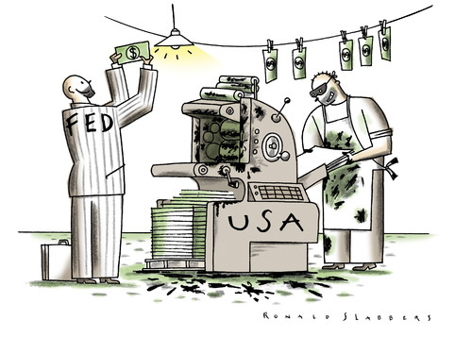
Extra Credit
1. Assume a 10% RRR, and that each bank loans out every available excess reserve.
Personal Deposit | Deposit (Money Supply) | Required Reserves (Assets) | Excess Reserves (Liabilities)
Person A | $2,000
Person B
Person C
Person D
Person E
Totals
2. Political Cartoon Analysis:
What do you think the event(s) or issue(s) are that inspired the cartoon? What is the cartoonist trying to portray in the cartoon?
Are there any real people/places in the cartoon? Who are these people?
Are there symbols in the cartoon? What are they and what do they represent?
What is your opinion of the cartoon, do you agree or disagree? Why?

Slide 59
The Functions of Financial Institutions Chart – pgs. 259 - 262
Characteristic | Description | Example
1. Storing Money
2. Saving Money
3. Loans
4. Mortgages
5. Credit Cards
6. Simple and Compound Interest
7. Banks and Profit
Banks provide a safe, convenient place for money.
Fireproof vaults, insured against robbery. FDIC insures up to $250,000.
Banks offer a variety of ways for people to save their money.
Savings, Checking, Money Market, Certificates of Deposit.
Banks provide the service of issuing loans.
Early banks issued gold-backed paper receipts. Today, banks loan money to businesses, people to make big ticket purchases.
A type of loan that is used to buy real estate.
Homes, commercial real-estate, mortgages usually last for 15,20 or 30 years.
Entitle their holders to buy goods and services based on the cardholder’s promise to pay for these goods and services
Mastercard, Visa, buy a sleeping bag and tent for $100, receive the bill for the month. Bank pays the store.
Interest is the price paid for the use of borrowed money, the initial amount is called the principal
$100 (principal), 5% (interest), annual payment $105. Compound interest pays interest on both principal and interest.
Banks earn profit on their interest.
Banks earn interest on loans, pay interest on borrowed money.

Slide 60
The Functions of Financial Institutions Chart – pgs. 259 - 262
Characteristic | Description | Example
1. Storing Money
2. Saving Money
3. Loans
4. Mortgages
5. Credit Cards
6. Simple and Compound Interest
7. Banks and Profit

