Slide 1
Chapter 9
Labor

Slide 2
Chapter 9, Section 1

Slide 3
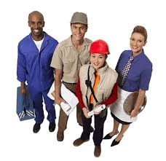
Labor Market Trends
Labor force- all non military people who are employed or unemployed.

Slide 4
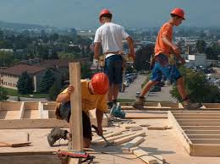
Labor Market Trends
A person is a part of labor force if:
1. Worked at least 1 week for pay
2. Worked for 15 hrs. without pay in a family business
3. Held job but did not work due to illness, vacation or bad weather.

Slide 5
Labor Market Trends
People not included in labor force are students, stay at home parents and retirees.

Slide 6
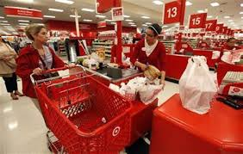
Labor Market Trends
Current labor market trends include an increase in service jobs accompanied by a decrease in manufacturing jobs

Slide 7
The Changing Labor Force
To get jobs today, people must have human capital- the education, training and experience that make them useful in the working place.
Education effects wage earnings (More education=more income)

Slide 9
The Changing Labor Force
Learning effect- the theory that education increases productivity and results in higher wages.
Screening effect- the theory that the completion of college indicates to employers that a job applicant is intelligent and hardworking.

Slide 10
Chapter 9, Section 2

Slide 11
Labor and Wages
Supply and Demand for Labor
Employment or unemployment in labor markets depends on the demand for workers and the number of jobs available.

Slide 12
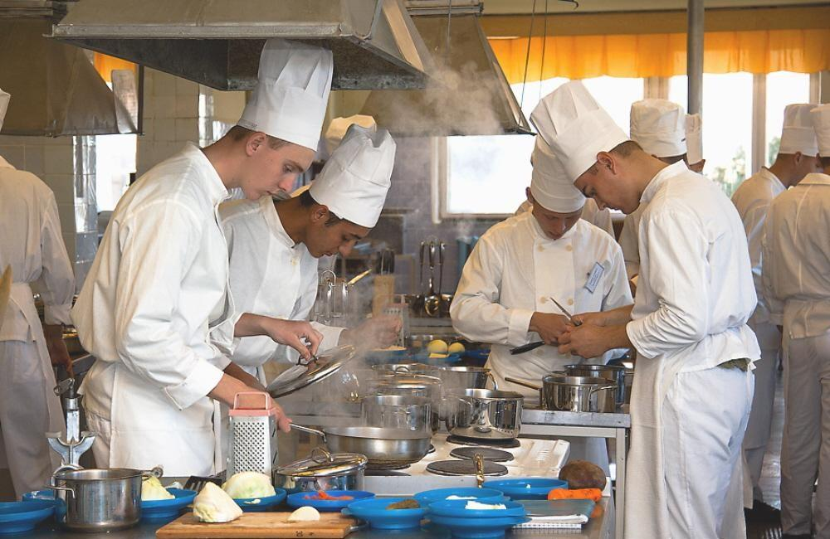
Labor and Wages
Derived demand- demand that is determined by demand for another good or service (Ex. cooks in market depend on restaurants)

Slide 13
Labor and Wages
Equilibrium wage- wage rate that produces neither an excess supply of workers nor an excess demand for workers in the labor market.
Wages for a particular job are determined by the equilibrium between supply and demand for workers for that job.

Slide 14
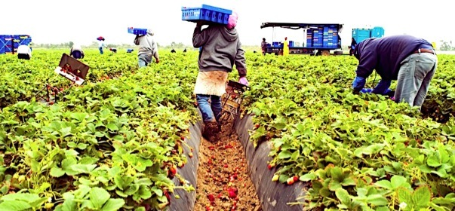
Wage and Skills Level
1. Unskilled Labor- labor that requires no specialized skills, education, or training (Ex. factory and farm workers)

Slide 15
Wage and Skill Level
What happens to job opportunities in low paying jobs when the minimum wage goes up? According to economic theory, the quantity of labor demanded goes down.

Slide 16
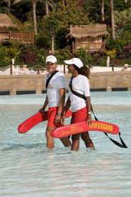
Wage and Skill Level
2. Semi skilled labor- labor that requires minimal specialized skills and education (Ex. lifeguards and some construction workers)

Slide 17
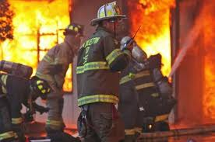
Wage and Skill Level
3. Skilled Labor- labor that requires specialized skills and training (Ex. firefighters and bank tellers)
4. Professional labor- labor that requires advanced skills and education (Ex. doctors and teachers

Slide 18
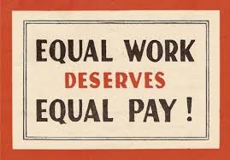
Wage Discrimination
Discrimination in wage has affected minorities and women.
Minorities and women were paid less, were last hired and first fired and denied positions of power.

Slide 19
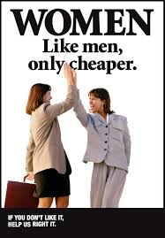
Wage Discrimination
Wage Discrimination- people who have the same job, skills, and education receive unequal pay.
Glass ceiling- invisible barrier that prevents women from advancing in businesses dominated by white men.

Slide 20
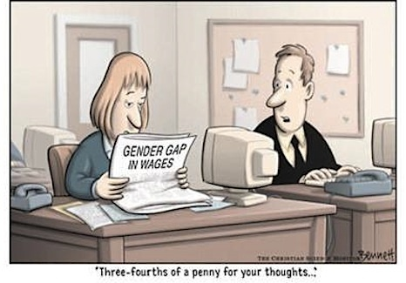
Wage Discrimination
Women today suffer from the wage gap. For every dollar a man makes, a woman makes .75 cents, doing same job.

Slide 21
Chapter 9, section 3

Slide 22
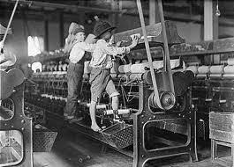
Organized Labor
Labor unions rose in the late 1800’s to fight for higher wages, shorter hours and safer work environments

Slide 23
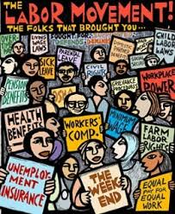
Organized Labor
Labor unions represent workers at a company. The company in return is required to bargain with the union to negotiate employment contracts.

Slide 24
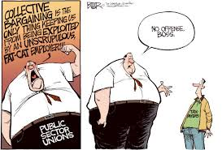
Organized Labor
Unions use collective bargaining, a process where union and company representatives meet to negotiate a contract, fight for wages and benefits, working conditions and job security.

Slide 25
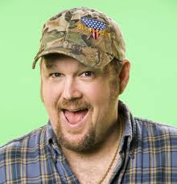
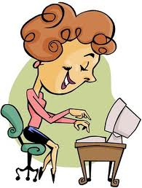
Organized Labor
Blue collar worker- those who work in industrial jobs who receive wages. (primarily union members)
White collar worker- someone in a professional or clerical job who earns a salary. (Non union members)

Slide 26
Organized Labor
In America today, there are more and more service jobs and less manufacturing jobs.

Slide 27
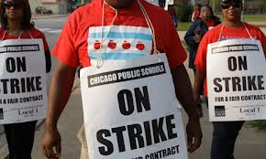
Organized Labor
If a union and company cannot come to a decision the union may choose to strike.
Strike- organized work stoppage intended to force an employer to address union demands.

Slide 28
Organized Labor
Today unions are on decline because the number of white collar jobs is increasing, decline in blue collar jobs, and some manufacturers have relocated to other countries where labor is cheaper or the American South.

Slide 29
Organized Labor
Unions are also on decline because of right to work laws, measures that ban mandatory union membership

