Slide 1
Chapter 7
Market Structures

Slide 2
Chapter 7
Section 1

Slide 3
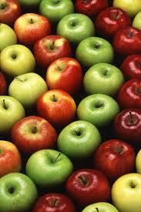
Perfect Competition
The market structure called perfect competition has the following conditions:
1. Many buyers and sellers participating in the market
2. Sellers offer identical products

Slide 4
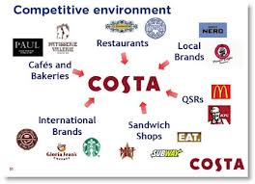
Perfect Competition
3. Buyers and sellers are well informed about products
4. Sellers are able to enter and exit the market freely

Slide 5
Perfect Competition
Yet perfect competition almost never happens. Imperfect competition refers to any market structure that is missing 1 or more of the characteristics of perfect competition.

Slide 6
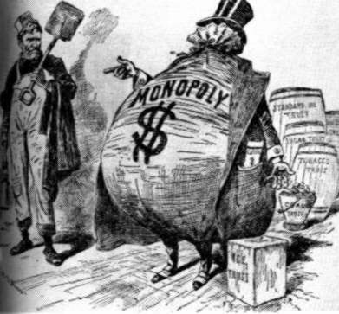
Perfect Competition
Imperfect market structures include: monopolies, monopolistic competition and oligopolies.

Slide 7
Chapter 7
Section 2

Slide 8
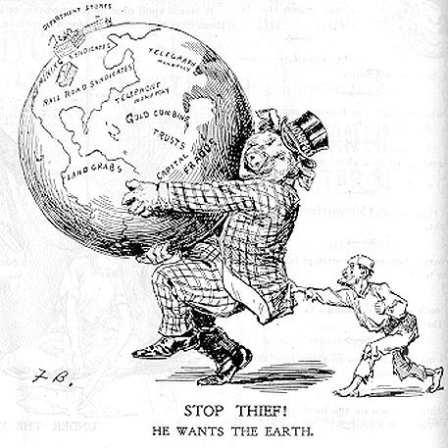
Monopolies
A monopoly forms when barriers prevent firms from entering a market that has a single supplier. It is bad because they can overcharge

Slide 9
Monopolies
Different types of monopolies:
Natural monopolies- a market that runs most efficiently when one large firm supplies all of the output. Government permits and regulates existence. Ex. Public water works

Slide 10
Monopolies
Government monopolies- created by government by giving patents and licenses that give inventors exclusive rights to sell a product or service for a period of time. Ex. Postal Service

Slide 11
Monopolies
Price discrimination- division of customers into groups based on how much they will pay for a good. Ex. Sr. discounts, student discounts & manufacturer rebates.

Slide 12
Chapter 7
Section 3

Slide 13
Monopolistic Competition and Oligopoly
So far we learned about two extremes: perfect competition and monopoly. Very few things actually fall into those categories. Instead, most fall into two additional categories economists call monopolistic competition and oligopoly.

Slide 14
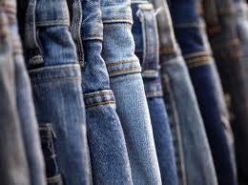
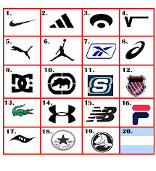
Monopolistic Competition and Oligopoly
In monopolistic competition, many companies compete in a open market to sell products that are similar but not identical. Examples: jeans, bread (loaf), shoes, drinks, etc.

Slide 15
Four Conditions of Monopolistic Competition
1. Many firms: many companies selling products
2. Few barriers to entry: anyone can sell products without much trouble getting started

Slide 16
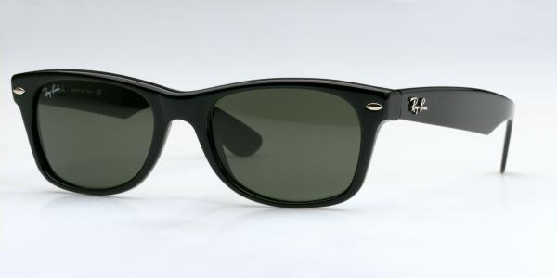
Four Conditions of Monopolistic Competition
3. Slight control over price: consumers are willing to pay more for some brands, but not too much more.
4. Differentiated products: even though products are similar, they have differences (Samsung v iPhone) (differentiation: making a product different from other similar products)

Slide 17
Non Price Competition
Firms try to compete with non-price competition, or attracting customers through style, service, or location, but not a lower price.

Slide 18
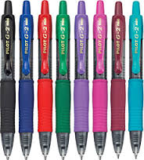
Non Price Competition
1. Physical Characteristics: size, color, shape, texture, taste Example: A pen is a stick with ink that writes, but we pay more for style or how it writes.

Slide 19
Non Price Competition
2. Location: Location is very important to a business's success.
3. Service level: restaurants: are expensive. Fast food: cheap. Both offer food.

Slide 20
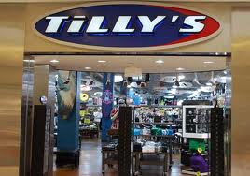
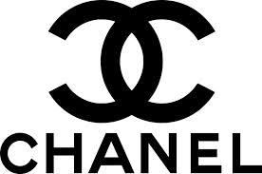
Non Price Competition
4. Advertising, image or status: Customers are willing to pay more for brand name clothes with logos

Slide 21
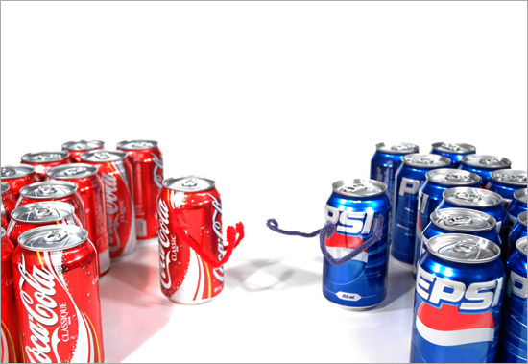
Oligopoly
An oligopoly is a market dominated by two to four firms producing 70%-80% of the output. Example: Pepsi, Coke

Slide 22
Oligopoly
Barriers to Entry
It can be tough to go up against these companies. Who would want to create a new soft drink to challenge Pepsi or Coke?

Slide 23
Oligopoly
Price war: a series of competitive price cuts that lower the market price below the cost of production example: PS3 lowers price, so does Xbox and Nintendo
Collusion: when businesses get together and set prices, divide the market, or limit production (illegal)

Slide 24
Oligopoly
Price fixing: an agreement among firms to charge one price for the same good (illegal)
Cartel: a formal organization of producers that agree to coordinate prices and production (illegal in the US)

Slide 25
Chapter 7
Section 4

Slide 26
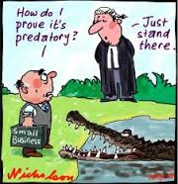
Market Power
Sometimes firms practice predatory pricing, or selling a product below cost to drive competitors out of the market.

Slide 27
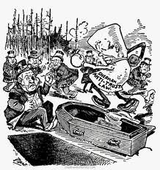
Government and Competition
Antitrust laws: laws that encourage competition
Trust: like a cartel; an illegal grouping of companies that discourages competition

Slide 28
Government and Competition
The US Gov. tries to make sure businesses act appropriately. The Federal Trade Commission makes sure that firms do not force out competition.
In 1890, the Sherman Antitrust Act gave the federal government the power to break up monopolies.
In 1982, US Gov. broke up ATT into 7 phone companies; prices did get lower.

Slide 29
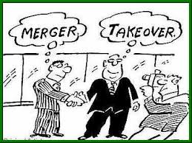
Government and Competition
Merger: the combination of two or more companies into a single firm
Sometimes the gov. tries to block mergers if they think it will not benefit the people. Generally, mergers mean less competition, and less comp. means higher prices.

Slide 30
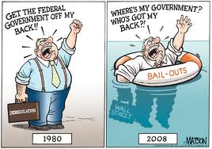
Deregulation
Deregulation: the removal of some government regulations/control over the industry are eliminated
Sometimes deregulation works great. Other times, it fails terribly.

Slide 31
Deregulation
Banks were deregulated 10 years ago. Profits skyrocketed. But today, we are seeing the backlash of no regulation.
California deregulated their electricity about 10 years ago. Remember when we had blackouts all the time? Deregulation was a total failure in that instance.

