Slide 1
Chapter 6
Prices

Slide 2
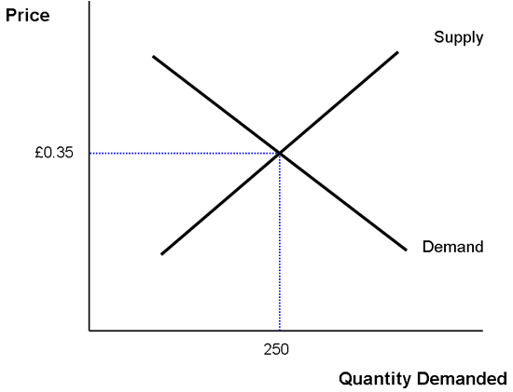
Balancing the Market
Equilibrium: the point at which quantity demanded and quantity supplied are equal or when the buyer will purchase exactly as much as sellers are willing to sell

Slide 3
Disequilibrium
Disequilibrium: any price or quantity not at equilibrium
Excess demand: when quantity demanded is more than quantity supplied. Example: when something sells out quickly (like digital cameras on Black Friday), there is excess demand.

Slide 4
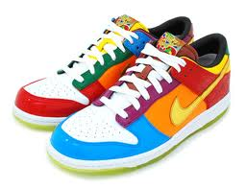
Disequilibrium
Excess supply: when the quantity supplied is more than the quantity demanded. A market in equilibrium that gets an increase in supply will experience quantity supplied exceeding quantity demanded, so the price will drop.
Example: Shoe City sold Nike at the equilibrium price of $50, Shoe Town moves in next door and also sells at $50. Now there is too much Supply, so the Price must drop

Slide 5
Government Intervention
Price ceilings are used on goods that are essential but too expensive for some consumers.
One example is rent control, a price ceiling placed on rent. In New York City, rent was being raised like crazy, so the government started rent control to keep the prices from getting out of control

Slide 6
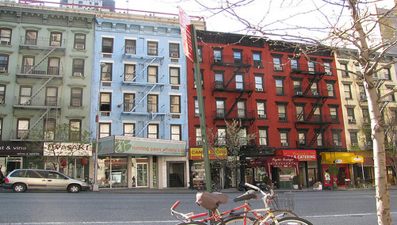
Government Intervention
Rent control makes apartments so cheap that there is excess demand. They don’t have enough apartments to meet demand.
Rent control reduces the quality of housing (more slums).
Landlords know they can’t make much money, so they don’t take care of the maintenance.

Slide 7
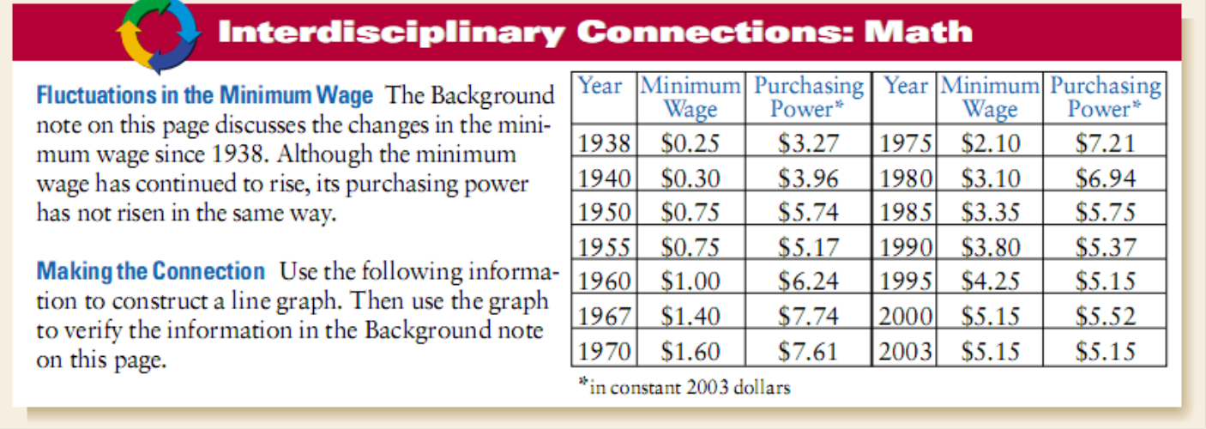
Price Floors
Price floor: a minimum price for a good or service
Example: minimum wage, a minimum price that an employer can pay a worker for an hour of labor.

Slide 8
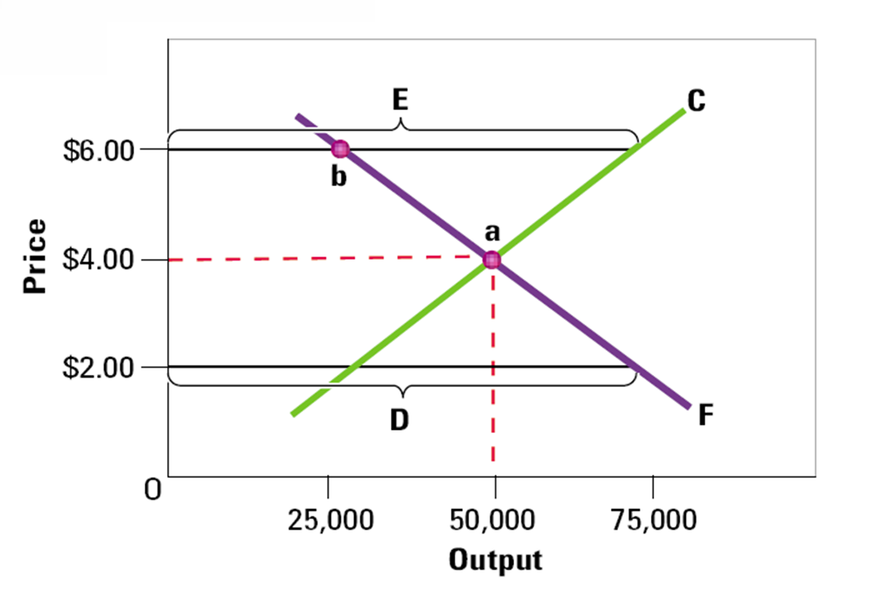
Label the point on the graph

Slide 9
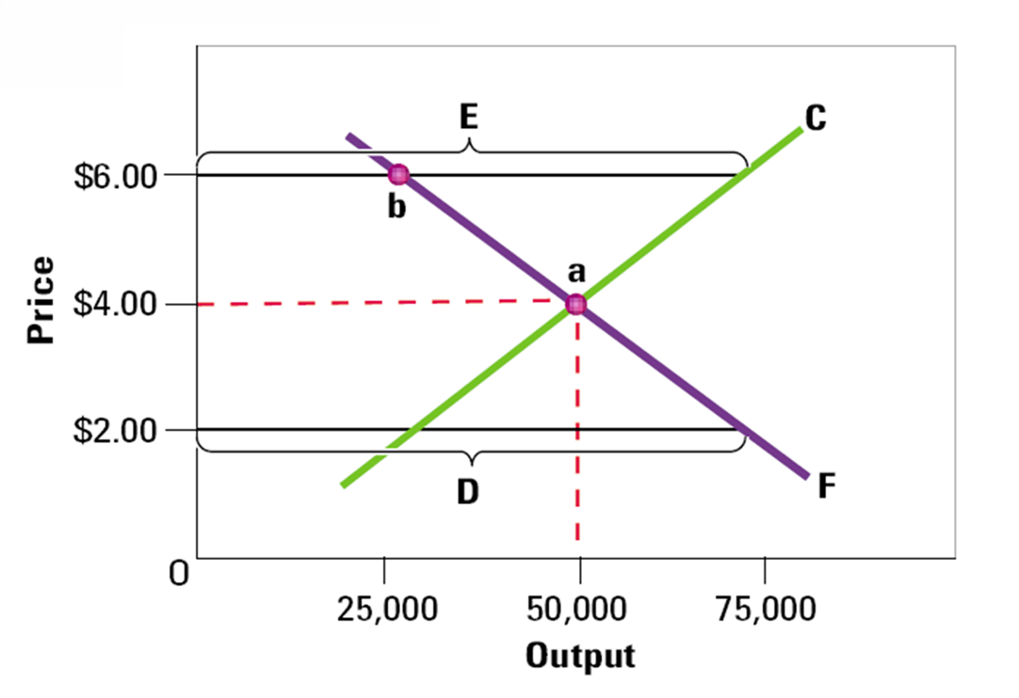
Label the point on the graph
A. Equilibrium point
B. Disequilibrium point
C. Supply curve
D. Price floor
E. Price ceiling
F. Demand curve

Slide 10
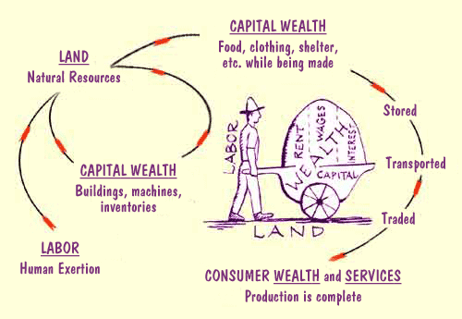
The Role Of Prices
Prices in a free market serve a vital role. Prices help move land, labor and capital into the hands of producers and buyers

Slide 11
The Role of Prices
Prices lead to an efficient allocation of resources. Resources are used in the most valuable and productive way according to the needs of consumers and producers.

