Slide 1
Chapter 4
Demand

Slide 2
Chapter 4, Section 1

Slide 3
Understanding Demand
Demand is the desire to own something and the ability to pay for it.
The Law of demand states that when a good’s price is lower, people will buy more of it. Higher prices = people buy less
Example: if pizza is a dollar, people buy more. If pizza is ten dollars, people will buy less.

Slide 4
Understanding Demand
Supply and Demand of goods determines the price and quantity produced of most goods.

Slide 5
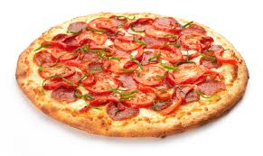
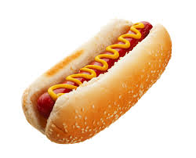
Understanding Demand
Substitution effects occur when people react to an increase in price by consuming less of that good and more of other goods.
Example: pizza got more expensive, so I ate hot dogs instead. Pizza’s price going up resulted in my buying more hot dogs.

Slide 6
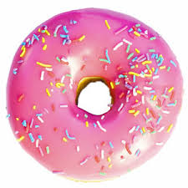
Understanding Demand
Income effect: the change in consumption resulting from a change in real income
Example: John buys two donuts every morning for $1 (50 cents each). One day the price goes up to $1 each. Now John just buys one. The demand for donuts goes down.
=

Slide 7
Understanding Demand
Demand schedule is a table that lists the quantity of a good a person will buy at each different price.

Slide 8
Understanding Demand
Market demand schedule is a table that lists the quantity of a good that all consumers in a market will buy at each different price

Slide 9
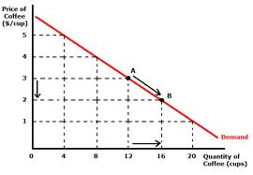
Understanding Demand
Demand curve: a graphic representation of a demand schedule
Lowest price on the bottom, highest on top. Lowest quantity on the left, highest on the right.

Slide 10
Chapter 4
Section 2

Slide 11
Shifts of the Demand Curve
People buy different amounts of goods and services when price goes up or down, this is called a change in quantity demanded.
Sometimes something other than prices causes demand as a whole to increase or decrease; this is called a change in demand.

Slide 12
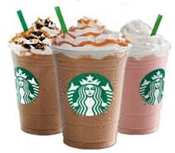
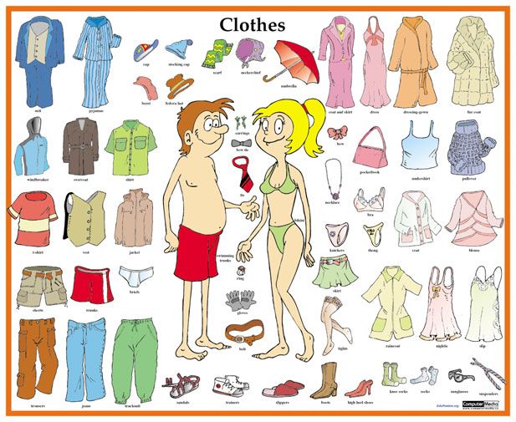
Shifts of the Demand Curve
Normal goods: stuff you want more of when you make more money
Example: groceries, clothes, etc.

Slide 13
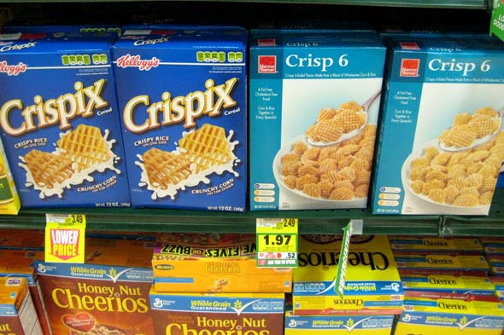
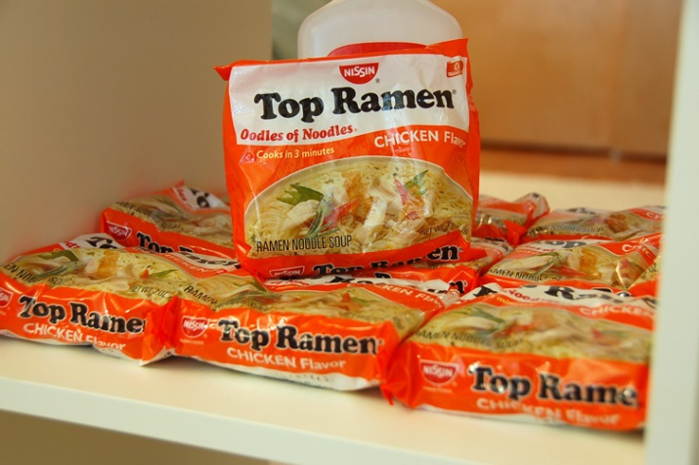
Shifts of the Demand Curve
Inferior goods: stuff you buy less of when you make more money
Example: top ramen, generic cereals, used cars

Slide 14
Shifts of the Demand Curve
There are 6 factors that effect a change in demand:
1. Consumer income- if income increase, demand increases. If income decreases, demand decreases.
Ex. Going out to eat
2. Consumer tastes- people buy more of a product when they are in season or advertised. (pumpkin latte at Starbucks or seasonal candy)

Slide 15
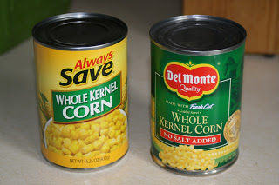
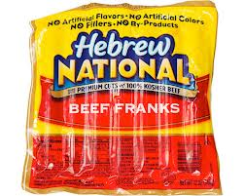
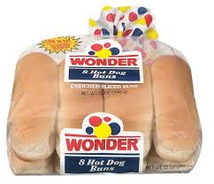
Shifts of the Demand Curve
3. Substitutes- goods used in place of another (ex. Generic brands)
4. Complements- two goods that are bought together and stay together. When demand of one product increases demand for the other increases as well. (Ex. When hot dogs go on sale, leads to increase in demand for hot dog buns.)

Slide 16
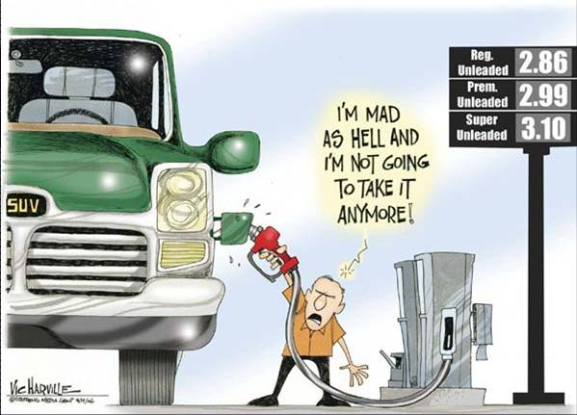
Shifts of the Demand Curve
5. Change in expectations- the way people think about the future affects what they buy.
If the price is expected to rise, current demand will rise. Future price related to current demand. (ex. Gasoline)

Slide 17
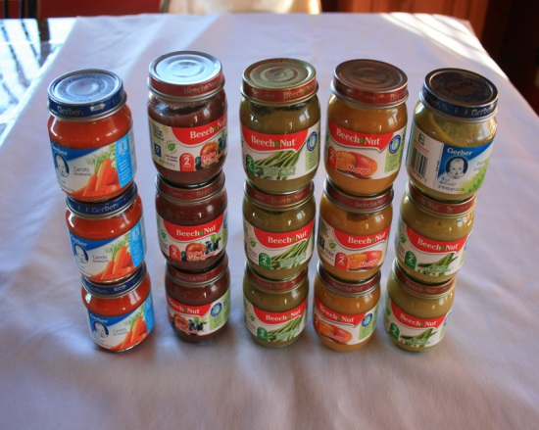
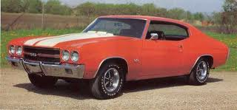
Shifts of the Demand Curve
6. Number of customers- as population increases, people buy more products. Demand as a whole increased.
Ex. Baby Boomers-Demand was raised for different goods with each age the Baby Boomers reached. They created an increased trend for goods

Slide 18
Shifts of the Demand Curve
Increase in demand causes demand curve to shift to the right. Ex. Increase in income or population
Decrease in demand causes demand curve to shift to the left. Ex. Income or population decrease.

Slide 19
Chapter 4
Section 3

Slide 20
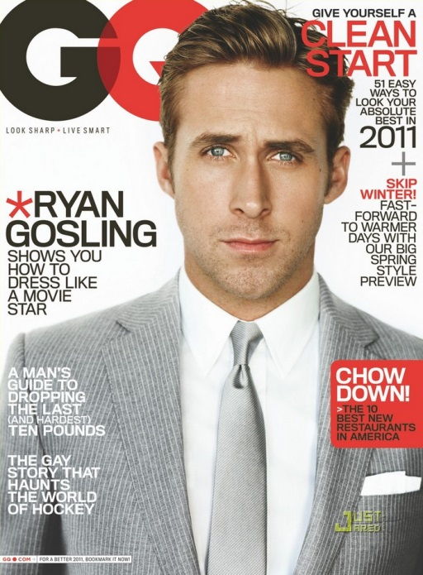
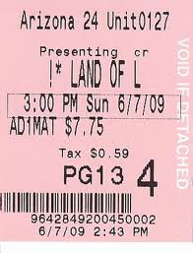
Elasticity of Demand
Elasticity of demand- a measure of how consumers react to a change in price.
Elastic- describes demand that is very sensitive to a change in price. Something you buy less of if there is a small increase in price in wants such as magazines, clothes, movie tickets etc.

Slide 21
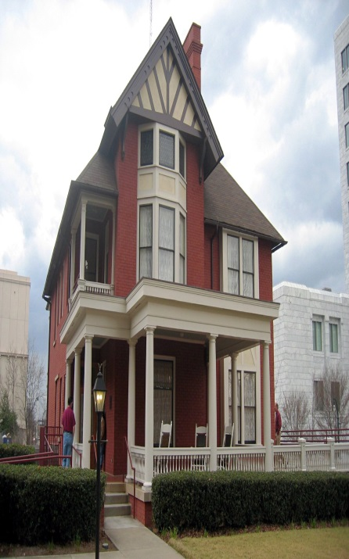
Elasticity of Demand
Inelastic- describes demand that is not very sensitive to price. Something you will buy despite the price such as gas, medicine and houses (needs).
Price increase for inelastic goods and services does not have significant impact on buying habits

Slide 22
Elasticity of Demand
3 questions can be asked to determine whether demand is elastic or inelastic:
1. Can the purchase be put off?
A product that is needed such as medicine, must be purchased no matter the cost, making demand inelastic. If product can be put off, demand is elastic.
Ex. Necessity vs Luxury= If prices are high necessities must be bought (milk) but luxuries can wait (steak)

Slide 23
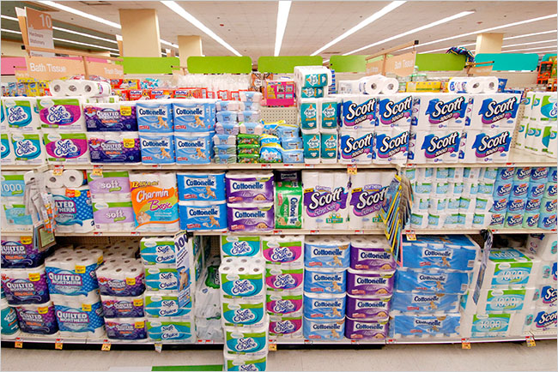
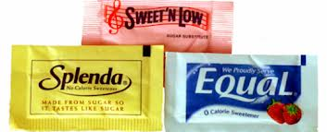
Elasticity of Demand
2. Are enough substitutes available?
If substitutes are available than buyers can choose the one that’s the best price. More substitutes=elastic. The fewer substitutes=inelastic.

Slide 24
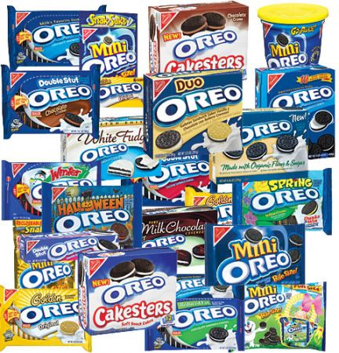
Elasticity of Demand
3. Does the purchase use a large portion of income?
Products that require small portion of income are inelastic. When products require large part of income, demand is elastic.

Slide 25
Elastic or Inelastic?
1. The price of insurance goes from $70 a month to $100 a month and the quantity demanded goes from 550 to 530 a day.
Elastic Inelastic
2. The price of the Carl’s Jr. Western Bacon Cheeseburger has dropped from $2.00 to $1.00 and the quantity demanded has gone from 200 a day to 475 a day.
Elastic Inelastic

Slide 26
Elastic or Inelastic?
3. The price of insulin medication goes from $75 a shot to $200 a shot and the quantity demanded goes from 450 shots a day to 425 shots a day.
Elastic Inelastic
4. The price of XBOX increases from $200 to $300 and the demand drops from 1000 sold a day to 25 sold a day.
Elastic Inelastic

