Slide 1
American free enterprise
Chapter 3

Slide 2
Chapter 3, section 1

Slide 3
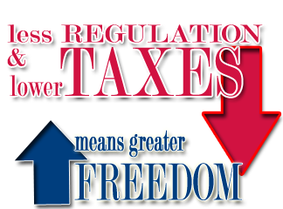
Benefits of free enterprise
Free enterprise- economy characterized by private ownership of business with little government intervention.

Slide 4
Benefits of Free enterprise
Free enterprise key characteristics:
1) Profit motive- the forces that encourage people to improve their material well-being. Ex. Businesses operating to maximize profits.
2) Open opportunity- the idea that everyone can compete in the market place.
3) Economic rights- legal equality for all races/sexes, private property rights, free contract rights and right of voluntary exchange.

Slide 5
Benefits of Free Enterprise
The consumer’s role in an enterprise system is to make choices. These choices signal to producers what to make and how much to make.

Slide 6
Benefits of Free Enterprise
Government role in enterprise system is to set manufacturing standards (FDA), environment protection laws (EPA) and to make sure the producers inform consumers.
Negative effect is gov. regulation stifles competition because of strict rules.

Slide 7
Section 2

Slide 8
Promoting Growth and Stability
Macroeconomics is concerned with the behavior of whole economies, countries and the whole world while Microeconomics is concerned with behaviors of smaller economic units such as households.

Slide 9
Promoting growth and Stability
When necessary, the government takes action to stabilize business cycles and encourage growth.

Slide 10
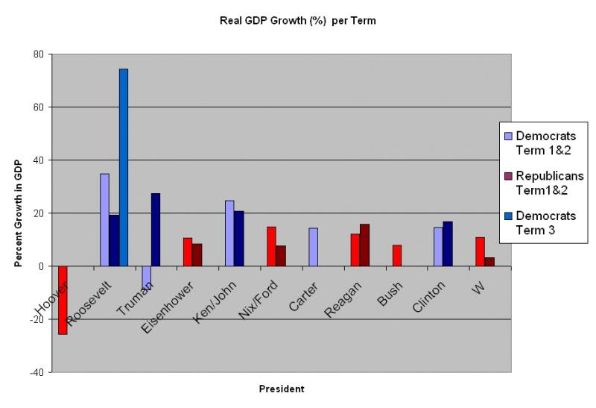
Promoting Growth and Stability
Gross Domestic Product (GDP) is the total value of all final goods and services produced in an economy
Calculating the nation’s GDP is one way economists measure economic well being

Slide 11
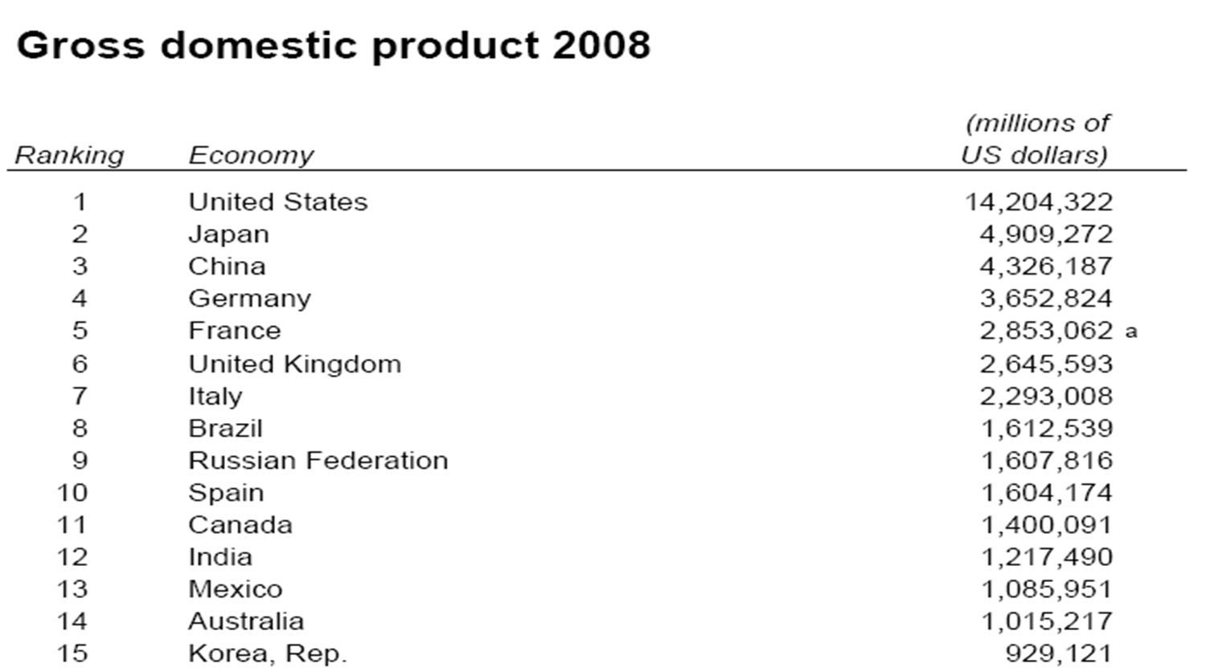
Promoting Growth and Stability
GDP around the world

Slide 12
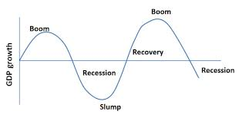
Promoting Growth and Stability
A business cycle is a period of economic expansion followed by a period of economic contraction
Business cycles on average last an average of 4 years, but they can be longer or shorter
Down periods are normal, but you want to look out for recessions and depressions

Slide 13
Promoting Growth and Stability
There are four things that affect the business cycle:
1) Interest rates. If interest rates are low, people invest more. If they are high, people invest less
2) External events/shocks. War, natural disasters, disruption of oil supply
3) Business Investment Levels. If sales rise, the company will invest more. If sales are low, the company will spend less
4) Consumer Expectations. If people believe the economy is doing well, people will spend more. If people believe the economy is doing bad (recession or depression), they spend less.

Slide 14
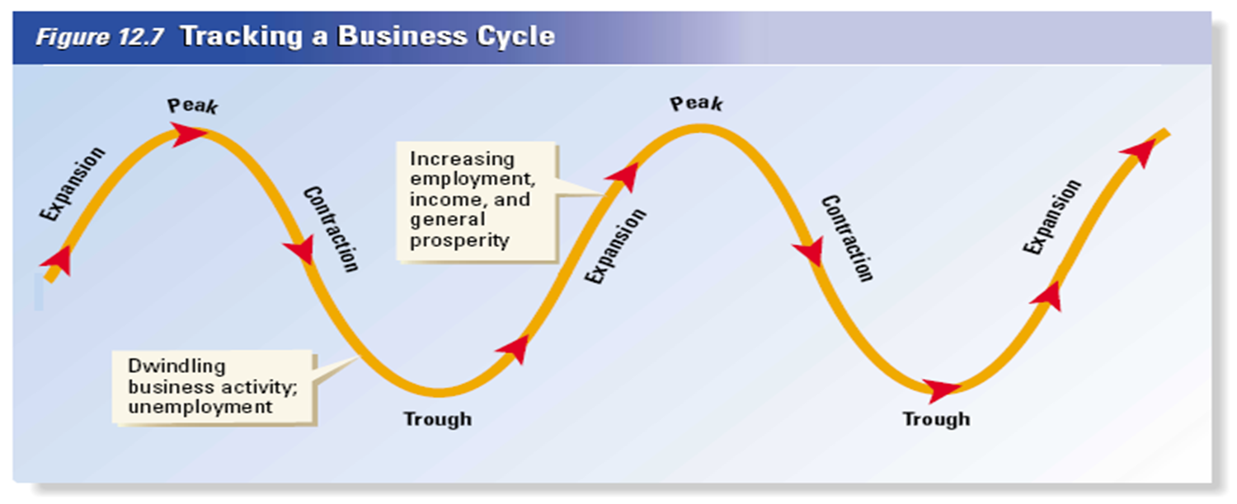
The Business Cycle
Expansion=Economic Growth
Peak= GDP stops rising
Contraction=Decline in GDP. Long decline=recession. Severe recession=depression
Trough=the lowest point of economic decline

Slide 15
The Great Depression
The Great Depression during the 1930s was the most severe economic downturn in the nation’s history and of industrial capitalism.

Slide 16
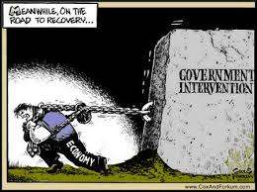
Because free enterprise is run by individuals and business acting in own self-interest, government is needed to prevent swings in economic behavior.

Slide 17
This is done by policies that aim to:
1) provide jobs for everyone who can work and keep unemployment rate between 4-6%.
2) Keep the economy growing
3) and making sure there are no drastic changes in price.
The federal government also encourages technical innovation by providing incentives for making huge profits in market place and protecting goods through copy rights.

Slide 18
Section 3

Slide 19
Providing Public Goods
Public goods- a shared good or service for which it would be impractical to make consumers pay individually and to exclude non-payers. Ex. Roads, national defense, national parks.
Market failure- a situation in which the market on its own does not distribute resources efficiently. Ex. Free riders
Externalities- are side effects of a decision by consumers/producers that has an impact on a 3rd party.

Slide 20
Providing Public Goods
Positive externalities- beneficial side effect on a third party. Ex. education, society benefits from having more productive workers.
Negative externalities- a cost incurred by a third party. Ex. A smoker exposes second hand smoke to non-smoker.

Slide 21
Section 4

Slide 22
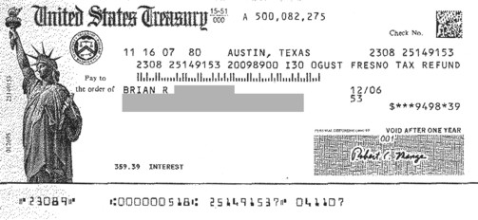
Providing a safety net
Government has to step in to provide aid to the poor. Social welfare programs include:
Temporary Assistance for Needy Families- cash payments for poor families
Social Security- cash payments for retired or disabled.

Slide 23
Providing a safety net
Unemployment insurance- cash payments to people who lost jobs.
Workers compensation- cash payment to workers hurt on job.
Poor can also receive food stamps, subsidized housing, and legal and medical aid.

