Slide 1
Chapter 16
The Federal Reserve and Monetary Policy

Slide 2
Chapter 16
Section 1

Slide 3
Banking History
The first United States Bank was created in 1790.
There has been plenty debate over how much control a central bank should have
After the Panic of 1907, Congress decided that a central bank was needed

Slide 4
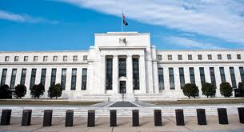
The Federal Reserve Act of 1913
The Federal Reserve system is a group of 12 regional, independent banks
Initially, the Federal Reserve System did not work well

Slide 5
The Federal Reserve Act of 1913
In 1935, the federal reserve system was adjusted so the system could respond to crises more effectively
Today, the Fed has more centralized power so regional banks can work together and represent their own concerns

Slide 6
Structure of the Federal Reserve
The Board of Governors- Federal Reserve system controlled by seven members. Actions taken by the Federal Reserve are called monetary policy

Slide 7
Structure of the Federal Reserve
Federal Reserve Districts- There are 12 districts, one bank per district
Member banks- all nationally chartered banks join the Fed.
The Federal Open Market Committee (FOMC)- Makes decisions involving interest rates and the growth of the U.S. money supply

Slide 8
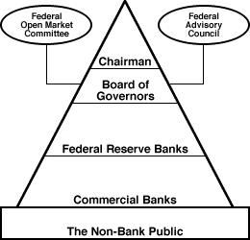
The Pyramid Structure of the Federal Reserve
About 40 percent of all banks belong to the Federal Reserve. They hold about 75% of all bank deposits in U.S.

Slide 9
Chapter 16
Section 2

Slide 10
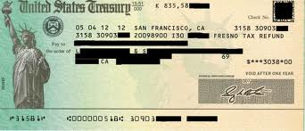
Serving Government
The Fed maintains a checking account for the Treasury Department and processes payments for social security checks and IRS refunds

Slide 11
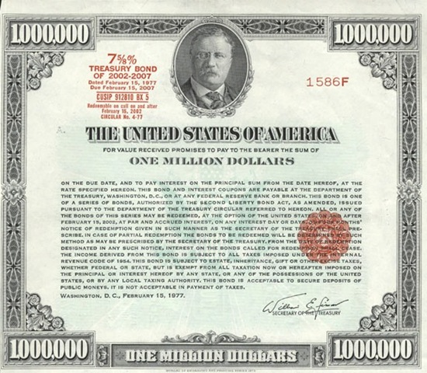
Serving Government
The Fed is the financial agent for the Treasury Department. They sell, transfer, redeem gov. securities. Handle funds raised from treasury bonds

Slide 12
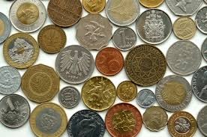
Serving Government
The district Federal Reserve Banks issue paper currency while the department of Treasury issues coins

Slide 13
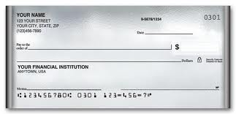
Serving Banks
Check clearing is the process by which banks record whose account gives up money and whose account receives money when someone writes a check

Slide 14
Serving banks
The Fed monitors banks reserves and make sure consumers understand loans as well as interest rates
Commercial banks can borrow money from the federal reserve. This is called the discount rate.

Slide 15
The Journey of a Check
Check
Check writer
Recipient
Federal Reserve Bank
Check Writer’s Bank

Slide 16
Regulating the Banking System
The Fed controls how much money is in circulation at one time
They also examine banks to make sure they are obeying laws and regulations
Could force banks to sell risky investment if net worth falls to law

Slide 17
Regulating the Money Supply
Factors that affect Demand for Money
1) Cash needed
2) Interest rates
3) Price levels
4) Level of income
The Fed does this in order to keep inflation rates stable

Slide 18
Chapter 16
Section 3

Slide 19
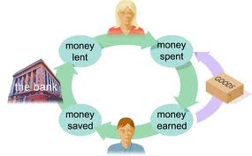
Money Creation
Money Creation is the process by which money enters into circulation

Slide 20
Money Creation
When you deposit money in your bank, the bank loans out some of that money.
The amount they do keep is the required reserve ratio (RRR)
The money is lent out to business and consumers, who also spend and deposit money=more money circulating

Slide 21
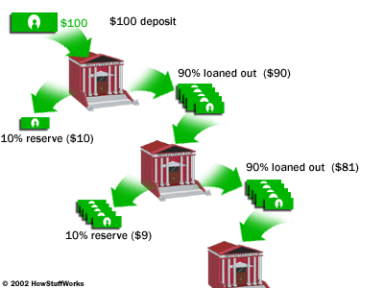

Slide 22
Reserve Requirements
A reduction in the RRR would allow banks to make more loans
This would lead to an increase in the money supply

Slide 23
Reserve Requirements
An increase in the RRR would require banks to hold more money
This method is not used often because it would cause too much disruption in the banking system

Slide 24
Discount Rate
If the Fed wants to encourage banks to loan more money, then they lower the discount rate
This leads to an increase in the money supply

Slide 25
Discount Rate
If the Fed wants to discourage banks from giving loans, then they increase the discount rate
This leads to a decrease in the money supply

Slide 26
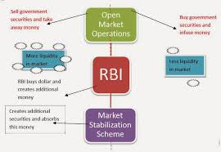
Open Market Operations
Open Market Operations are the buying and selling of government securities to alter the money supply

Slide 27
Open Market Operations
Bond Purchases lead to an increase in the money supply
When the Fed sells bonds, it takes money out of the money supply

Slide 28
Chapter 16
Section 4

Slide 29
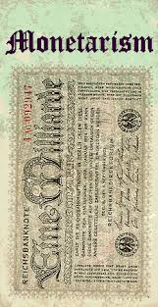
How Monetary Policy Works
Monetarism is the belief that the money supply is the most important factor of macroeconomic performance

Slide 30
How Monetary Policy Works
Interest Rates are high when the money supply is low
Interest rates are low when the money supply is high

Slide 31
How Monetary Policy Works
An easy money policy is when the Fed increases the money supply, decreasing interest rates cause the economy to expand
A tight money policy is when the Fed decreases the money supply and increase interest rates, cause the economy to contract

Slide 32
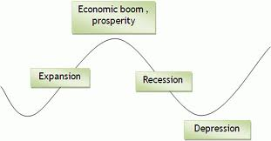
The Problem of Timing
Properly timed economic policy will minimize inflation
If stabilization is not times properly, could make the business cycle worse

Slide 33
Policy lags
When there is a delay in implementing monetary policy, this is called a inside lag
Caused by identifying shift in the business cycle
The time it takes for monetary policy to take affect once enacted is called a outside lag

Slide 34
Anticipating the Business Cycle
The Federal Reserve must react to current trends as well as anticipate changes in the economy
Expansionary policies enacted at the wrong time could lead to high inflation

Slide 35
Anticipating the Business Cycle
The economy can take 2-6 years to recover
Since it takes a while, policymakers can guide the economy back to stable levels of output and prices

